Slide 1
Argobots A Lightweight Low-level Threading/Tasking Framework
https://collab.cels.anl.gov/display/ARGOBOTS/
Sangmin Seo
Argonne National Laboratory
sseo@anl.gov

Slide 2
Outline
Background and Motivation
Argo and Concurrency Group
Related Work
Argobots
Execution Model
Migration
Programming
Performance Analysis and Optimizations
Comparison
Applications
Argobots Ecosystem
Collaborations
Summary
Git and Documentation

Slide 3
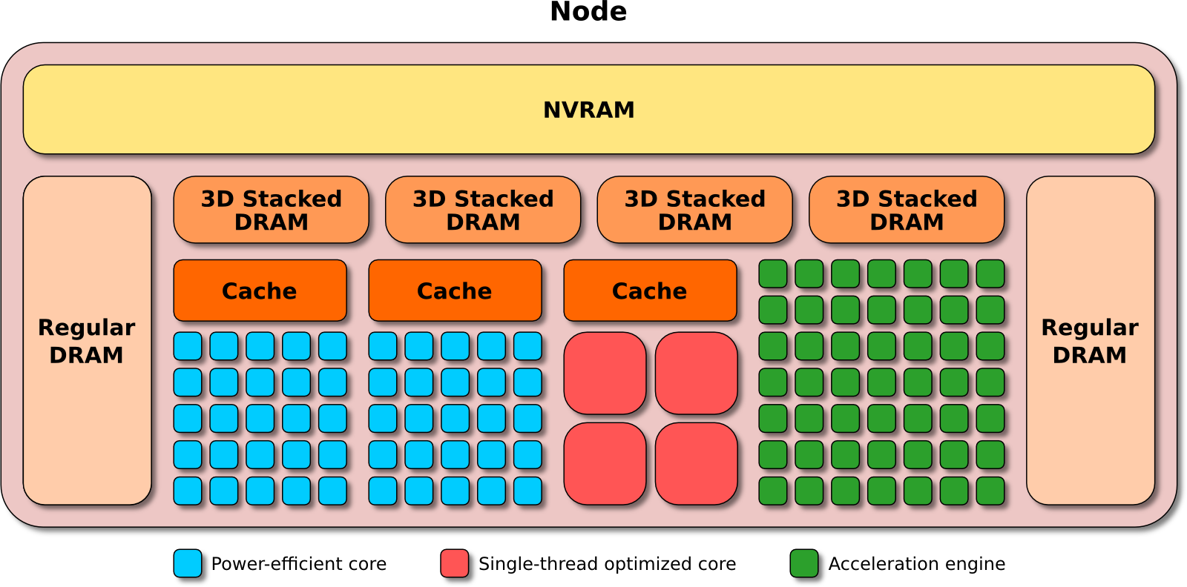
Argo: An Exascale Operating System and Runtime
Key Areas of Innovation:
Node OS
Core-specialization permits multiple, concurrent kernels
Lightweight Concurrency
Fine-grained tasks and lightweight threads for massive intra-node parallelism
Backplane
Event, Control, and Performance backplanes to support global optimizations
Global OS
“Enclave” abstraction to allow global optimization of power, resilience, performance

Slide 4
Argo Concurrency Team
Argonne National Laboratory (ANL)
Pavan Balaji (co-lead)
Sangmin Seo
Abdelhalim Amer
Marc Snir
Pete Beckman (PI)
University of Illinois at Urbana-Champaign (UIUC)
Laxmikant Kale (co-lead)
Prateek Jindal
Jonathan Lifflander
University of Tennessee, Knoxville (UTK)
George Bosilca
Thomas Herault
Damien Genet
Pacific Northwest National Laboratory (PNNL)
Sriram Krishnamoorthy
Past Team Members:
Cyril Bordage (UIUC)
Esteban Meneses (University of Pittsburgh)
Huiwei Lu (ANL)
Yanhua Sun (UIUC)

Slide 5
Argo Concurrency: Problem & Goal
Problem
Massive on-node parallelism is inevitable
Existing solutions do not effectively deal with such parallelism for on-node threading/tasking or for PUT/GET in the presence of such tasks/threads
Goal
Provide runtime systems utilizing massive on-node parallelism

Slide 6
Argo Concurrency: Approaches
High-level tasking models (CilkBots, TASCEL, PaRSEC)
High-level dynamic execution environments
Explore high-level tasking frameworks that will take advantage of the low-level threading and communication frameworks
CilkBots and TASCEL: PNNL & UIUC
PaRSEC: UTK
Investigate high-level programming models, e.g., Charm++, that are specialized in dynamic execution environments and can exploit the low-level threading and communication frameworks
UIUC
Argobots interoperability with a PUT/GET model
Argobots: A lightweight low-level threading/tasking framework
Design new communication libraries that work with such low-level threading models
Argonne
Develop a new low-level threading/tasking model that will allow us to expose the hardware characteristics of exascale computing systems more effectively
Argonne & UIUC

Slide 7
Argo Concurrency: Recent Results & Impact
Recent results
Initial development of the “Argobots” threading/tasking library
Initial design of extending inter-node communication in the presence of user-level threads and tasks
Prototype development of Charm++, CilkBots, TASCEL, and PaRSEC over Argobots
Impact
The new models developed would impact both legacy and new programming models that take advantage of massive on-node parallelism

Slide 8

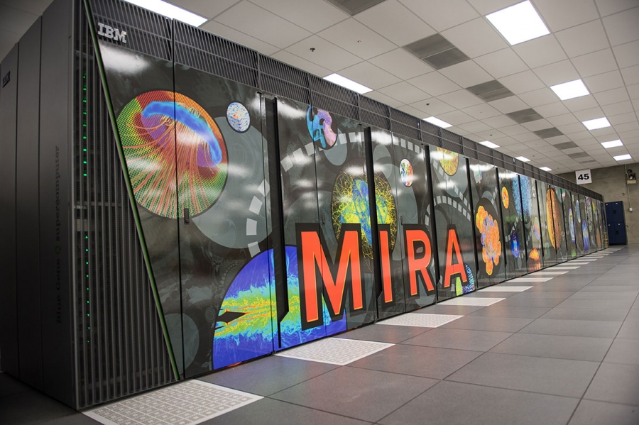
Challenges of Future Exascale Systems
Heterogeneous, massively parallel compute nodes
High performance, complex network topologies
Tens of thousands of compute nodes to manage
Constrained resources (power, I/O)

Slide 9
Top500 Supercomputers Today
Tianhe-2 (Intel Xeon + Xeon Phi):
Titan (Cray XK7 + Nvidia K20x):
Sequoia (BlueGene/Q):
K computer (SPARC64):
Mira (BlueGene/Q):
3,120,000 cores
560,640 cores
1,572,864 cores
705,024 cores
786,432 cores
Number of cores per socket in Top500
Total number of cores in Top500 rank #1

Slide 10
Massive On-node Parallelism
The number of cores is increasing
Massive on-node parallelism is inevitable
Existing solutions do not effectively deal with such parallelism with respect to on-node threading/tasking systems or with respect to off-node communication in the presence of such tasks/threads
How to exploit?
core
Core-level Parallelism

Slide 11
Massive On-node Parallelism
MPI process with many OpenMP threads
To address massive on-node parallelism, the number of work units (e.g., threads) must increase by 100X
MPI+OpenMP is sufficient for many apps, but implementation is poor
Today MPI+OpenMP == MPI+Pthreads
Pthread abstraction is too generic, not suitable for HPC
Lack of fine-grained scheduling, memory management, network management, signaling, etc.
Better runtime can significantly improve MPI+OpenMP performance and support other emerging programming models
core
Current situation:
One or more MPI processes per node
Each MPI process has limited internal parallelism typically with OpenMP
MPI Process communication is often serialized
Notes:
Thesis:
Choice: MPI+OpenMP or NewProgMod
For MPI+OpenMP =➔ MPI + PThreads (in modern implementations)
Problem: To address massive on-node parallelism, the number of work units (threads, etc) must increase by 100X
Pthread abstraction is not good for: mem, interconnect, schedule, tasks

Slide 12
Shortcomings today? Pthreads (1/2)
Nesting
Execution time for 36 threads in the outer loop
int in[100][100], out[100][100];
#pragma omp parallel for
for (i = 0; i < 100; i++) {
petsc_voodoo(i);
}
petsc_voodoo(int x)
{
#pragma omp parallel for
for (j = 0; j < 100; j++)
out[x][j] = cosine(in[x][j]);
}
Lower is better
Why is traditional OpenMP’s performance so bad? The compiler cannot analyze petsc_voodoo to know whether the function might ever block or yield, so it has to assume that it might. Therefore a stack is needed to facilitate it. Creating additional pthreads for each nesting is the simplest way to achieve this.
Notes:
MPI+OpenMP == MPI+Pthreads → problem of:
Nested parallelism
Very simple OpenMP example, that Kothe gets, and has bad performance.
Implementation problem from an model/abstraction issue: (external library call, blocking)
Does voodoo block? If compiler can’t tell, we need a full preemptable stack

Slide 13
Shortcomings today? Pthreads (2/2)
Tasks of application mapped to a group of pthreads
How about these communications?
Wait or context switch?
Work units intermixed with blocking calls (such as communication calls) can cause idle cores
map & schedule
pthreads
C
C
C
C
computation
communication
Need lightweight mechanisms to switch tasks!
Notes:
Thesis: Without an abstraction for tasks, we simply put them in a bucket in a Pthread, so when there is communication, the pthread blocks, so the remainder of the tasks stall

Slide 14
Pthreads vs. User-level Threads (ULTs)
Average time for creating and joining one thread
pthread: 6.6us - 21.2us (avg. 34,953 cycles)
ULT (Argobots): 78ns - 130ns (avg. 191 cycles)
ULT is 64x - 233x faster than pthread
How fast is ULT?
L1$ access: 1.112ns, L2$ access: 5.648ns, memory access: 18.4ns
Context switch (2 processes): 1.64us
* measured using LMbench3
Notes:
2 x Intel Xeon E5-2699 v3 (2.30GHz): 36 physical cores (72 threads)

Slide 15
User-Level Threads (ULTs)
Lightweight threads managed by runtime system
Low context-switch overhead
More than one ULT can be mapped to a single OS thread
Growing interest
Argobots, Converse threads, MassiveThreads, Nanos++, Qthreads, etc.
ULTs :
Kernel threads :
Core
Core
Core
Core
Core
Core
Core
Core

Slide 16
User-Level Threads (ULTs)
U
User-level Thread (ULT)
Lightweight thread with low context-switch overhead
More than one ULT can be mapped to a single OS thread
May not be executed concurrently
Why ULTs?
Conventional threads (e.g., pthreads) are too expensive to express massive parallelism
If we create pthreads more than # of cores (i.e., oversubscription):
context-switch and synchronization overhead will increase dramatically
ULTs can mitigate high overhead of pthreads but need explicit control
Where to use?
To better overlap computation and communication/IO
Low context-switching overhead of ULTs can give more opportunities to hide communication/IO latency
To exploit fine-grained task parallelism
Lightweight ULTs are more suitable to express massive task parallelism
U
U
OS thread

Slide 17
Related Work
Growing interests in ULT and task libraries
Converse threads, Qthreads, MassiveThreads, Nanos++, Cilk, OpenMP task, C++11 task, C++17 coroutine proposal, etc.
Qthreads
Lightweight portable ULT library
Locality-aware work-stealing scheduler
MassiveThreads
A user-level lightweight thread library
Designed for High Productivity Languages
Provide pthread-compatible API and semantics
Blocking I/O can trigger context switches
Exploit a work-stealing scheduler
Pros
Easy to use with pthreads-like interface
Cons
Runtime tries to do something smart (e.g., work-stealing)
This may conflict with the user’s demand

Slide 18
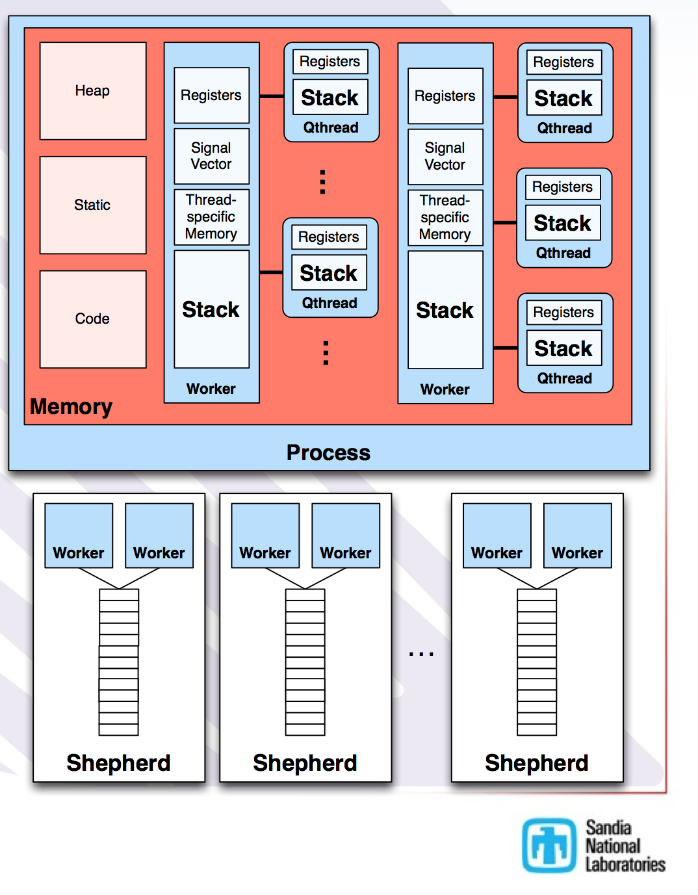
Qthreads
Lightweight portable ULT library
Locality-aware workstealing scheduler
Supports multiple programming models: Chapel, OpenMP
Pros and cons when integrated with MPI:
Pros: provides an easy interface to use ULT
Cons: lacks an explicit semantic for parallelism. All ULTs can potentially run in parallel thus lock is needed everywhere
Qthreads Architecture
Source: [Friar Tuck’s Chapel]

Slide 19
Argobots Overview
Lightweight Low-level Threading/Tasking Framework
Separation of abstraction and mapping to implementation
Massive parallelism
Exec. Streams guarantee progress
Work Units execute to completion
Clearly defined memory semantics
Consistency domains
Provide Eventual Consistency
Software can manage consistency
Work Units can access any consistency domain
Support explicit memory placement and movement
Put/Get/Send/Recv requires library call in OSR, but could be transparent at application level
Exploring fault model and atomics
Work
Unit
Execution
Stream
Execution Model
Consistency
Domain
Consistency
Domain
Consistency
Domain
CD1
CD1
CD1
Consistency Domain
CD0
Cache-Coherent
Memory
Non-Coherent
Memory
* Current team members: Pavan Balaji, Sangmin Seo, Halim Amer (ANL), Laxmikant Kale, Prateek Jindal (UIUC)

Slide 20
Argobots Execution Model
Execution Streams (ES)
Sequential instruction stream
Can consist of one or more work units
Mapped efficiently to a hardware resource
Implicitly managed progress semantics
One blocked ES cannot block other ESs
User-level Threads (ULTs)
Independent execution units in user space
Associated with an ES when running
Yieldable and migratable
Can make blocking calls
Tasklets
Atomic units of work
Asynchronous completion via notifications
Not yieldable, migratable before execution
Cannot make blocking calls
ES₁
Sched
ES_{n}
U
S
E
...
T
U
E
T
T
S
E
U
T
T
E
S
U
T
E
Scheduler
Pool
ULT
Tasklet
Event
Argobots Execution Model
Scheduler
Stackable scheduler with pluggable strategies
Synchronization primitives
Mutex, condition variable, barrier, future
Events
Communication triggers

Slide 21
Explicit Mapping ULT/Tasklet to ES
The user needs to map work units to ESs
No smart scheduling, no work-stealing unless the user wants to use
ES₁
ES₂
Benefits
Allow locality optimization
Execute work units on the same ES
No expensive lock is needed between ULTs on the same ES
They do not run concurrently
A flag is enough
U0
T1
U1
T2
U2
U4
U3
U5

Slide 22
Stackable Scheduler with Pluggable Strategies
Associated with an ES
Can handle ULTs and tasklets
Can handle schedulers
Allows to stack schedulers hierarchically
Can handle asynchronous events
Users can write schedulers
Provides mechanisms, not policies
Replace the default scheduler
E.g., FIFO, LIFO, Priority Queue, etc.
ULT can explicitly yield to another ULT
Avoid scheduler overhead
Sched
U
S
E
T
U
E
T
T
S
E
U
S
U
U
U
U
T
T
E
yield()
yield_to(target)

Slide 23
Argobots Innovations
What did not work with user-level threads and why it will work now
Lot of work on user-level threads in the past: Qthreads, MassiveThreads, Nanos++, Converse threads, …
Focus has been on how to build the best runtime system
Great work, but conflicting interests with high-level programming models
E.g., if qthreads does its own work-stealing, how can OpenMP manage locality (which users count on)
The Argobots approach
Enabling technology, but not a policy maker
High-level languages/libraries such as OpenMP, Charm++ have more information about the user application (data locality, dependencies)
“Working well” with these high-level languages is important
Explicit model: enables dynamism, but always managed by high-level systems
Explicit scheduling allows determinism: allows for other libraries (such as MPI) to reason about concurrency and protection requirements; improves performance
Notes:
OpenMP has more information, so they want their own scheduler
CilkBots wants to do data locallity aware scheduling
Examples: I/O “which is most likely to finish first? Schedule that first”
No premption, within an ES, and other threads can’t run (helps lock issues)
Argobots has a memory model for consistency
Stacked Scheduler: Like MPI Communicators

Slide 24
Interfaces for Shrink/Expand Events
MPI+Argobots
Charm++
CilkBot
PaRSEC
programming model runtimes and applications
callback functions
ABT_event_add_callback()
ABT_event_del_callback()
missing part
ES₀
ES₁
ES₂
ES_{n-1}
E
...
NRM
Sched
Sched
Sched
Sched
E
E
socket
Argobots
ABT_ENV_POWER_EVENT_HOSTNAME
ABT_ENV_POWER_EVENT_PORT
[Argobots] Connect to NRM using a socket on ABT_init()
[Runtimes/applications] Register callback functions for shrink/expand events
[Runtimes/applications] Deregister callback functions when they terminate
[Argobots] Disconnect from NRM on ABT_finalize()

Slide 25
Shrink/Expand Event Handling
Shrinking
prog. model runtime/application
1
2
4
E
E
E
ES₀
ES₁
ES₂
- Any scheduler on any ES can check and handle events
- ES₀ cannot be stopped
Sched
Sched
Sched
3
NRM
U
6
7
5
ES₁ picks an event, which requests ES₂ to be stopped
Ask the application using callbacks whether ES₂ can be stopped
If OK, mark ES₂ to need to stop so when the scheduler on ES₂ checks events, it can be stopped
Notify the application that ES₂ will be stopped
Create a ULT on ES₀
When the scheduler on ES₂ stops, ES₂ is terminated
After ES₂ is terminated, the ULT frees ES₂ and sends a response to NRM

Slide 26
Shrink/Expand Event Handling
Expanding
prog. model runtime/application
E
E
E
1
2
3
4
ES₀
ES₁
ES₂
Sched
Sched
Sched
NRM
5
ES₀ picks an event, which requests to create an ES₂
Ask the application using callbacks whether it can create ES₂
If OK, invoke a callback function so the application creates ES₂
Create ES₂
Send a response to NRM

Slide 27
Two Views of Execution Model
ES-centric view
ULTs and tasklets are bound to ESs
Pool/queue-centric view
ULTs and tasklets are bound to pools/queues
ES
ES
ES
sq
S
S
S
q1
q1
S
S
S
q1
S
S
S
q1
q1
gq
gq

Slide 28
Work Unit Migration
Considered two views of execution model
Location: ES or pool
Source: the location in which work units are residing
Target: the location to which work units are migrated
Basic migration model
Work units can be migrated from source to target
ULTs are migratable if they are not terminated
Migratable states: READY, BLOCKED, RUNNING
Tasklets are only migratable when they are in READY state
Migration can be blocking or non-blocking operation depending on the request
The callback function will be invoked if it is set
The scheduler of either source or target executes the callback function
The user can specify where the callback function is executed

Slide 29
Why Migration?
Load balancing
Migrate work units to ESs which are idle
Work sharing/stealing
Locality
Migrate work units to locations where locality is better exploited
NUMA
Migrate work units to a closer location (e.g., socket) if the memory near the location is accessed frequently
Reduce memory access latency

Slide 30
Two Migration Approaches
Work unit-centric migration
Migrating a WU to a different ES
Migrating a WU to a different pool
Making a WU orphaned
Making a WU have no association with any ES or any pool
Location-centric migration
Migrating WUs between ESs
Migrating WUs between pools
Migrating WUs from one ES to a pool
Migrate WUs from one pool to an ES

Slide 31
Migrating a WU to a Different Location
int ABT_thread_migrate_to_xstream(...)
int ABT_thread_migrate_to_pool(...)
int ABT_task_migrate_to_xstream(...)
int ABT_task_migrate_to_pool(...)
Global Pool
Global Pool
ES
ES
WU
pool
pool
pool

Slide 32
Making a WU Orphaned
int ABT_thread_make_orphaned(ABT_thread thread)
int ABT_task_make_orphaned(ABT_task task)
Two routines are blocking calls.
Global Pool
The WU becomes having no association with any ES or any pool.
ES
WU
The user has to add the WU to the location (ES or pool) where it needs to go.
pool

Slide 33
Migrating WUs between Locations
int ABT_xstream_migrate_threads(...)
int ABT_xstream_migrate_threads_to_pool(...)
int ABT_xstream_migrate_tasks(...)
int ABT_xstream_migrate_tasks_to_pool(...)
int ABT_pool_migrate_threads(...)
int ABT_pool_migrate_threads_to_xstream(...)
int ABT_pool_migrate_tasks(...)
int ABT_pool_migrate_tasks_to_xstream(...)
Global Pool
Global Pool
N work units
WU
ES
WU
ES
...
WU
pool
pool
target
source

Slide 34
How to Write Argobots Code
Initialize
ES₁
Sched
ES_{n}
Create pools
P
P
Create schedulers
U
S
E
...
S
S
T
U
E
T
T
S
E
Create ESs
ES
ES
U
T
T
E
Create ULTs/tasklets
U
T
S
U
T
E
Scheduler
Pool
ULT
Tasklet
Event
Join & Free
Argobots Execution Model
Finalize

Slide 35
Hello World with Argobots
#include <stdio.h>
#include "abt.h"
#define NUM_XSTREAMS 4
void thread_hello(void *arg) {
int rank, tid = (int)(size_t)arg;
ABT_xstream_self_rank(&rank);
printf("[U%d:E%d] Hello, world!\n", tid, rank);
}
int main(int argc, char *argv[]) {
ABT_xstream xstreams[NUM_XSTREAMS];
ABT_pool pools[NUM_XSTREAMS];
ABT_thread threads[NUM_XSTREAMS];
int i;
examples/hello_world_thread.c

Slide 36
Hello World with Argobots (cont’d)
ABT_init(argc, argv);
/* Create ESs */
ABT_xstream_self(&xstreams[0]);
for (i = 1; i < NUM_XSTREAMS; i++)
ABT_xstream_create(ABT_SCHED_NULL, &xstreams[i]);
/* Get the first pool associated with each ES */
for (i = 0; i < NUM_XSTREAMS; i++) {
ABT_xstream_get_main_pools(xstreams[i], 1, &pools[i]);
}
/* Create ULTs */
for (i = 0; i < NUM_XSTREAMS; i++) {
ABT_thread_create(pools[i], thread_hello,(void *)i,
ABT_THREAD_ATTR_NULL, &threads[i]);
}
The primary ES has already been created.
Same for the main ULT.
Work units are added to pools
examples/hello_world_thread.c

Slide 37
Hello World with Argobots (cont’d)
/* Join & Free */
for (i = 0; i < NUM_XSTREAMS; i++) {
ABT_thread_join(threads[i]);
ABT_thread_free(&threads[i]);
}
for (i = 1; i < NUM_XSTREAMS; i++) {
ABT_xstream_join(xstreams[i]);
ABT_xstream_free(&xstreams[i]);
}
ABT_finalize();
return 0;
}
examples/hello_world_thread.c

Slide 38
Using Predefined Pools and Schedulers
Predefined pools
E.g., ABT_POOL_FIFO
Pool access modes
ABT_POOL_ACCESS_PRIV: Used by only one ES
ABT_POOL_ACCESS_SPSC: Producers on ES1, consumers on ES2
ABT_POOL_ACCESS_MPSC: Producers on any ES, consumers on the same ES
ABT_POOL_ACCESS_SPMC: Producers on the same ES, consumers on any ES
ABT_POOL_ACCESS_MPMC: Producers on any ES, consumers on any ES
Predefined schedulers
ABT_SCHED_DEFAULT: default scheduler (same as BASIC)
ABT_SCHED_BASIC: basic scheduler
ABT_SCHED_PRIO: priority scheduler

Slide 39
Creating Predefined Schedulers
/* Create schedulers */
for (i = 0; i < NUM_XSTREAMS; i++) {
ABT_sched_predef predef;
predef = (i % 2) ? ABT_SCHED_BASIC : ABT_SCHED_PRIO;
ABT_sched_create_basic(predef, 0, NULL, ABT_SCHED_CONFIG_NULL,
&scheds[i]);
}
/* Create ESs */
ABT_xstream_self(&xstreams[0]);
ABT_xstream_set_main_sched(xstreams[0], scheds[0]);
for (i = 1; i < NUM_XSTREAMS; i++) {
ABT_xstream_create(scheds[i], &xstreams[i]);
}
Runtime-configured pools will be used for this scheduler
Need to change the main scheduler of primary ES
ES₁
ES₂
PRIO
BASIC
P
P_{H}
P_{M}
P_{L}
examples/sched_predef.c

Slide 40
Getting Associated Pools
/* Get the pools associated with each scheduler */
for (i = 0; i < NUM_XSTREAMS; i++) {
ABT_sched_get_num_pools(scheds[i], &num_pools[i]);
pools[i] = (ABT_pool *)malloc(num_pools[i] * sizeof(ABT_pool));
ABT_sched_get_pools(scheds[i], num_pools[i], 0, pools[i]);
}
/* Create ULTs */
for (i = 0; i < NUM_XSTREAMS; i++) {
for (k = num_pools[i] - 1; k >= 0; k--) {
size_t tid = (i + 1) * 10 + k;
ABT_thread_create(pools[i][k], thread_hello, (void *)tid,
ABT_THREAD_ATTR_NULL, NULL);
}
}
ES₁
ES₂
PRIO
BASIC
P
P_{H}
P_{M}
P_{L}
examples/sched_predef.c

Slide 41
Sharing a Pool between Schedulers
/* Create a shared pool */
ABT_pool_create_basic(ABT_POOL_FIFO, ABT_POOL_ACCESS_MPMC,
ABT_TRUE, &shared_pool);
/* Create schedulers */
for (i = 0; i < NUM_XSTREAMS; i++) {
ABT_sched_create_basic(ABT_SCHED_DEFAULT, 1, &shared_pool,
ABT_SCHED_CONFIG_NULL, &scheds[i]);
}
ES₁
ES₂
ES₃
ES₄
Sched
Sched
Sched
Sched
Shared Pool
examples/sched_shared_pool.c

Slide 42
Stacking a Scheduler
/* Create a new scheduler */
ABT_sched_create_basic(ABT_SCHED_BASIC, 0, NULL,
ABT_SCHED_CONFIG_NULL,
&sched);
/* Create tasks */
ABT_sched_get_pools(sched, 1, 0, &tar_pool);
for (i = 0; i < NUM_TASKS; i++) {
ABT_task_create(tar_pool, task_hello, (void *)(size_t)i,
NULL);
}
/* Push the scheduler to the current pool */
ABT_thread_self(&cur_thread);
ABT_thread_get_last_pool(cur_thread, &cur_pool);
ABT_pool_add_sched(cur_pool, sched);
examples/sched_stack.c

Slide 43
Writing a Scheduler
int ABT_sched_create(ABT_sched_def *def, int num_pools, ABT_pool *pools, ABT_sched_config config, ABT_sched *newsched)
[in] def: definition required for scheduler creation
[in] num_pools: number of pools associated with this scheduler
[in] pools: pools associated with this scheduler
[in] config: specific config used during the scheduler creation
[out] newsched: handle to a new scheduler

Slide 44
Writing a Scheduler (cont’d)
typedef struct {
ABT_sched_type type; /* ULT or tasklet */
/* Functions of the scheduler */
ABT_sched_init_fn init;
ABT_sched_run_fn run;
ABT_sched_free_fn free;
ABT_sched_get_migr_pool_fn get_migr_pool;
} ABT_sched_def;

Slide 45
Writing a Scheduler (cont’d)
A simple work-stealing scheduler
examples/sched_user.c
ES₁
ES₂
ES₃
ES₄
Sched
Sched
Sched
Sched
P₁
P₂
P₃
P₄
Create pools with ABT_POOL_ACCESS_MPMC
Share all pools among schedulers
Make each scheduler access its pool first

Slide 46
User-Defined Pool
int ABT_pool_create(ABT_pool_def *def, ABT_pool_config config, ABT_pool *newpool)
[in] def: definition required for pool creation
[in] config: specific config used during the pool creation
[out] newpool: handle to a new pool

Slide 47
User-Defined Pool (cont’d)
typedef struct {
ABT_pool_access access; /* Access type */
/* Functions to manage units */
ABT_unit_get_type_fn u_get_type;
ABT_unit_get_thread_fn u_get_thread;
ABT_unit_get_task_fn u_get_task;
ABT_unit_is_in_pool_fn u_is_in_pool;
ABT_unit_create_from_thread_fn u_create_from_thread;
ABT_unit_create_from_task_fn u_create_from_task;
ABT_unit_free_fn u_free;
/* Functions to manage the pool */
ABT_pool_init_fn p_init;
ABT_pool_get_size_fn p_get_size;
ABT_pool_push_fn p_push;
ABT_pool_pop_fn p_pop;
ABT_pool_remove_fn p_remove;
ABT_pool_free_fn p_free;
} ABT_pool_def;

Slide 48
Performance Analysis and Optimizations

Slide 49
Microbenchmark
for i = 0 to M:
for j = 0 to N:
create ULT j
end for
for j = 0 to N:
join ULT j
end for
for j = 0 to N:
free ULT j
end for
end for
0
1
…
N-1
Stack size per ULT: 16KB

Slide 50
Experimental Setup
CPU
2 x Intel Xeon E5-2699 v3 (2.30GHz)
36 physical cores (72 hardware threads)
Memory
128 GB
OS
RedHat 7 (kernel 3.10.0-327.el7.x86_64)
Compiler
gcc 4.8.5
Methodology
Create, join and free ULTs on one ES
Measure cycles with rdtsc and cache/TLB misses using PAPI

Slide 51
Baseline: Performance Breakdown
create (76% - 78%) > free (12% - 17%) > join (8% - 11%)
memory allocation/deallocation takes most time in create/free
ULT’s stack space including its context data

Slide 52
Memory Pool
Maintain a memory pool of ULT stacks
2¹⁰ ULTs: 2,235 cycles -> 133 cycles
2²⁰ ULTs: 3,892 cycles -> 1,016 cycles
2¹⁰ ULTs: 479 cycles -> 29 cycles
2²⁰ ULTs: 675 cycles -> 150 cycles
Notes:
create: up to 16.8 times speedup
free: up to 16.5 times speedup

Slide 53
Using Huge Pages
ULTs use separate stack area (16KB by default) that is larger than the normal page size (4KB)
Causes TLB misses when a lot of ULTs are executed
Memory pool itself cannot solve this
Huge pages can mitigate TLB misses
2MB huge pages are supported on the target platform
Integrate using huge pages in the memory pool
Explicit use of huge pages by calling mmap()
Implicit use of transparent huge pages by calling posix_memalign()
Huge pages improve the performance of all create, join, and free operations
Average TLB misses become almost zero

Slide 54
Using Huge Pages (cont’d)
create/free time
2¹⁰ ULTs: 133 cycles -> 105 cycles
2²⁰ ULTs: 641 cycles -> 564 cycles
2¹⁰ ULTs: 29 cycles -> 24 cycles
2²⁰ ULTs: 150 cycles -> 72 cycles

Slide 55
Using Huge Pages (cont’d)
Also improved the performance of join operation
TLB misses became almost zero
2¹⁰ ULTs: 233 cycles -> 207 cycles
2²⁰ ULTs: 564 cycles -> 443 cycles
2¹⁰ ULTs: 0.85 misses -> 0.01 misses
2²⁰ ULTs: 2.51 misses -> 0.01 misses

Slide 56
Data Structure Access Pattern
1
64
Pop from pool
Termination/migration check
Setup context
New scheduler check
Manage state
Context switch
(Access the stack)
64
3
5
4
56
6
2
Bad access pattern!
Internal ULT data structure

Slide 57
Data Structure Reorganization
1
1
2
3
3
4
5
5
6
4
6
2
Sematic-oriented
Performance-oriented
Fields are clustered by semantics
Arrange fields by access orders in the performance critical path
3 cache lines are accessed
2 cache lines are accessed!

Slide 58
Data Structure Reorganization (cont’d)
2¹⁰ ULTs: 0.00 misses -> 0.00 misses
2²⁰ ULTs: 8.68 misses -> 7.65 misses
2¹⁰ ULTs: 235 cycles -> 176 cycles
2²⁰ ULTs: 569 cycles -> 419 cycles

Slide 59
Reducing Context-Switch Overhead
Context switch steps
U0
1. Save U0's context (i.e., stack pointer, registers) in U0's stack
2. Restore U1's context from U1's stack
U1
3. Execute U1's function
When U0 context switches to U1, if U0 terminates
U0’s context does not need to saved
It will not be used anymore
We can skip the step 1 above in this case

Slide 60
Reducing Context-Switch Overhead (cont’d)
2¹⁰ ULTs: 235 cycles -> 121 cycles
2²⁰ ULTs: 569 cycles -> 433 cycles

Slide 61
Join Optimization 1: Scheduler By-pass
Access pattern in the join operation affects the performance due to the cache behavior
Original
Scheduler By-pass
0
0
0 → scheduler
scheduler → 1
1 → scheduler
…
0 → 1
1 → 0
0 → 2
…
S
1
2
3
1
2
3
# of context switches: 2N
# of context switches: 2(N-1)
Scheduler accesses ULT1 - ULT3
ULT0 accesses ULT1-ULT3 again to check the status of all ULTs
By-pass the scheduler and return to the joining ULT
ULT0 accesses ULT1-ULT3 once

Slide 62
Join Optimization 1: Scheduler By-pass (cont’d)
2¹⁰ ULTs: 235 cycles -> 128 cycles
2²⁰ ULTs: 569 cycles -> 407 cycles

Slide 63
Join Optimization 2: Bulk Join Operation
# of context switches affects the performance
Scheduler By-pass
Chaining
0
0
0 → 1
1 → 0
0 → 2
…
0 → 1
1 → 2
2 → 3
3 → 0
1
2
3
1
2
3
# of context switches: 2(N-1)
# of context switches: N
(N -1) x ABT_thread_join()
1 x ABT_thread_join_many()

Slide 64
Join Optimization 2: Bulk Join (cont’d)
2¹⁰ ULTs: 235 cycles -> 111 cycles
2²⁰ ULTs: 569 cycles -> 316 cycles

Slide 65
Optimized Join
Applied all optimizations
2¹⁰ ULTs: 235 cycles -> 48 cycles
2²⁰ ULTs: 569 cycles -> 178 cycles

Slide 66
Putting It All Together
2¹⁰ ULTs: 2,948 cycles (c: 2,235, j: 235, f:479) -> 160 cycles (c: 89, j: 48, f: 24)
2²⁰ ULTs: 5,136 cycles (c: 3,892, j: 569, f: 675) -> 734 cycles (c: 500, j: 178, f: 57)
18.4x speedup
7.0x speedup

Slide 67
comparison

Slide 68
Qualitative Measures: Execution
levels of hierarchy
How many levels of execution units/concepts are used?
Ex) group (ES/shepherd/worker) vs. work unit (thread/ULT/tasklet)
# of work unit types
How many types of work units?
Ex) thread vs. ULT vs. tasklet
thread support
OS-level or user-level thread, with a private stack, and yieldable
tasklet support
atomic work unit (not yieldable), without a private stack
group control
Can users control the number of ESs/shepherds/workers (i.e., the number of cores used) at run time?

Slide 69
Qualitative Measures: Scheduling
locality/affinity mapping
Is it possible to map a thread to a specific group?
yield_to
Can a thread yield control to a specific thread, not scheduler?
migration
Can a thread be migrated to a different group?
plug-in scheduler
Is it possible to use a different scheduler instead of default one?
stackable scheduler
Can different schedulers be stacked?
Different programming models may need their own schedulers when their work units are executed
group scheduler
Can each group have its own scheduler?
A certain group (ES) may want to use a different scheduler

Slide 70
Qualitative Measures: Communication & Event
put/get to remote node
Are put/get operations to remote nodes supported?
event
Is there a mechanism for the asynchronous event handling?
system call
Are blocking system calls handled specially?

Slide 71
Qualitative Measures: Memory
variable stack size
Is each thread able to use a different size of stack?
Not all threads need to use the same size of stack
hierarchical memory
Is the hierarchical memory considered?
hooks to memory allocation
Does the runtime provide hooks to memory allocation?
coherence domains
Are memory coherence domains supported? I.e., is it possible to synchronize memory according to coherence domains?

Slide 72
Qualitative Measures: Execution & Scheduling
 | Argobots | Pthreads | Massive Threads | Qthreads
levels of hierarchy | 2 | 1 | 2 | 3
# of work unit types | 2 | 1 | 1 | 1
thread support | ✔ | ✔ | ✔ | ✔
tasklet support | ✔
group control | ✔ |  | ✔ | ✔
locality mapping | ✔ | ✔ |  | ✔
yield_to | ✔
migration | ✔ |  |  | ✔
plug-in scheduler | ✔ | ✔ | ✔ | configure¹
stackable scheduler | ✔
group scheduler | ✔
¹ only possible at configure time

Slide 73
Qualitative Measures: Comm. & Memory
 | Argobots | Pthreads | Massive Threads | Qthreads
put/get to remote node | plan |  |  | ✔
event | ✔
system call | plan | ✔ | ✔¹ | ✔²
variable stack size | ✔ | ✔ | ✔
hierarchical memory | plan
hooks to memory allocation | plan
coherence domains | plan
¹ override some I/O system calls
² provide alternative functions for some system calls

Slide 74
Swift/T
A new implementation of the Swift language for high-performance computing
The Swift script is translated into an MPI program
Swift vs. Argobots
Swift is a concurrent language with C-like syntax
The task granularity of Swift/T is larger
Leaf tasks are external functions written in C, C++, Fortran, Python, R, Tcl, Julia, Qt Script, or executable programs
Swift coordinates the distribution of data to these tasks and schedules them for concurrent execution across the nodes of a large system

Slide 75
Legion?
A data-centric programming model for distributed heterogeneous architectures
Provides abstractions to explicitly declare properties of program data
E.g., organization, partitioning, privileges, and coherence
Extracts parallelism and issues the necessary data movement operations according to the application-specified data properties
 | Legion | Argobots
Similarities | Target users: DSL and library developers
Differences | Data-centric Task-based execution model Implicit control of execution by the runtime (Users have no concurrency control) | Execution unit-centric Providing both ULTs and tasks Explicit control of execution by the user and the scheduler (Users can control concurrent execution of execution units)

Slide 76
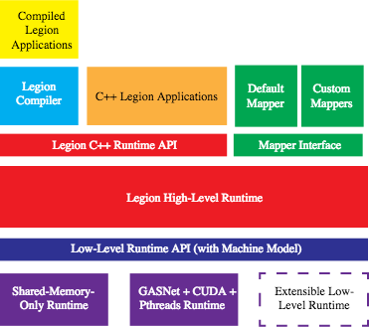
Legion vs. Argobots
Argobots
this layer
Legion Programming System Architecture

Slide 77
Quantitative Measures (Benchmarks)
create/join time
Time taken to create and join a ULT/tasklet with various number of ESs
create/join time tolerance
Minimum, maximum, and average time for each ULT on each ES to create and join another ULT
yield time
Yield overhead for each ULT library according to the number of ESs
Evaluation machine
2 x Intel Xeon E5-2699 v3 (2.30GHz): 36 cores (72 threads)

Slide 78
Create/Join Time
Ideal scalability
If the ULT runtime is perfectly scalable, the time should be the same regardless of the number of ESs

Slide 79
Create/Join Time Tolerance (Qthreads)

Slide 80
Create/Join Time Tolerance (MassiveThreads (W))

Slide 81
Create/Join Time Tolerance (Argobots)

Slide 82
Yield Time

Slide 83
Applications

Slide 84
Sparse Matrix-Matrix Multiplication with RMA
MPI_Get
MPI_Get
MPI_Accumulate
Thread 0
Two implementations:
MPI+Pthreads: a thread is a pthread
MPI+Argobots: a thread is a ULT
MPI_Accumulate
Thread 1
Process 0
Thread 0
Thread 1
Process 1
Notes:
MPI_Win_flush_all after Gets.

Slide 85
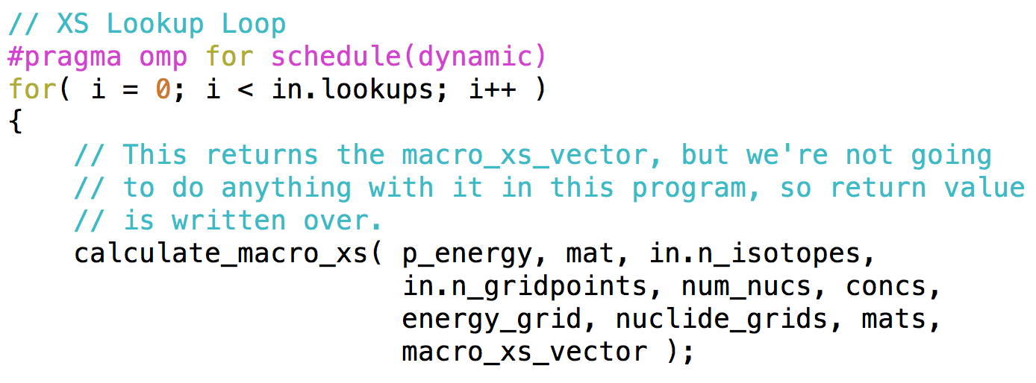
Mini-App: XSBench in CESAR
A mini-app representing a key computational kernel of the Monte Carlo neutronics application OpenMC
Primarily used to investigate "on node parallelism" issues
Parallelized by OpenMP
Main loop: XS lookup loop

Slide 86
XSBench: XS Lookup Loop
If we parallelize the XS lookup loop like OpenMP
Nothing special
We can write a pthread-like Argobots code
Performance is almost similar
Different way?
Find the bottleneck
irregular memory access

Slide 87
XS Lookup Loop: Different Parallelization
idx
idx
idx
idx
idx
...
idx
...
sort
lookup
lookup
lookup
lookup
lookup
...
lookup
Original Parallelization
Sort idxes before lookup

Slide 88
XS Lookup Loop: Argobots Implementation
idx
idx
...
idx
idx
idx
...
idx
ULT
ULT
sort
sort
...
scheduler
scheduler
lookup
lookup
...
lookup
lookup
lookup
...
lookup
Task
Task
Task
Task
Task
Task
Execution Stream 0
Execution Stream N-1

Slide 89
XSBench: Performance Results
Input size: large (5.6 GB data, 15,000,000 lookups)
Target machine
2 x Intel Xeon E5620 (2.40GHz) -> 8 cores
24 GB memory
too much overhead!
1.7x speedup
3.5x speedup

Slide 90
XSBench: Argobots Optimizations
Reducing mostly task creation overhead
Need a custom allocator!
* SFMalloc: A Lock-Free and Mostly Synchronization-Free Dynamic Memory Allocator for Manycores,
in PACT '11, Seo et al.

Slide 91
XSBench: Performance Results with Optimizations
47% reduction
9.5% faster

Slide 92
XSBench: Scalability

Slide 93
NVRAM Emulation

Slide 94
Memory Hierarchy
Registers
Caches
Latency & Size
increase
DRAM
Bandwidth
increase
NVRAM
DISK

Slide 95
Latency Hiding with Argobots
When there is a blocking call or a wait operation, switch to another ULT instead of waiting
Library or application should interoperate with Argobots
Need to explicitly invoke a yield function
I.e., cooperative scheduling
DRAM
nvram_prefetch_nb()
nvram_prefetch()
NVRAM
ABT_thread_yield()

Slide 96
Programming Models for NVRAM
Address qualifier
nvram int data[100];
for (i = 0; i < 100; i++) {
data[i] = compute(data[i]);
}
Directives
nvram int data[100];
#pragma nvram prefetch(data, 100)
for (i = 0; i < 100; i++) {
data[i] = compute(data[i]);
}
Compiler will generate blocking NVRAM read/write code.
Compiler will generate NVRAM prefetching code.
Entire ES will block whenever there is a blocking operation.

Slide 97
NVRAM Emulation
Blocking prefetch
nvram int data[100];
nvram_prefetch(data, sizeof(int), 100);
for (i = 0; i < 100; i++) {
data[i] = compute(data[i]);
}
Non-blocking prefetch with yield
event = nvram_prefetch_nb(data, sizeof(int), 100);
while (!nvram_test(event))
ABT_thread_yield();
for (i = 0; i < num; i++) {
data[i] = compute(data[i]);
}
Thread will block during prefetch
Thread will switch to another

Slide 98
NVRAM Emulation
Split-phase
nvram int data[100];
nvram_prefetch(data, sizeof(int), 100);
for (i = 0; i < 100; i++) {
data[i] = compute(data[i]);
}
nvram_prefetch(buf, size, num) {
nvram_prefetch_cb(buf, size, num, cb_fn, future);
/* Suspend thread */
ABT_future_wait(future);
}
/* Called when prefetch is done */
cb_fn(future) {
/* Awaken the thread */
ABT_future_set(future, 1);
}

Slide 99
NVRAM Emulation
32%
100 ULTs in a single ES prefetch 4096 bytes 100 times.
[Assumption] Each prefetch takes around 3 usec.

Slide 100
Argobots Yield Operations
Provide explicit control of ULT execution inside an ES
Can be used to overlap communication and computation
Two kinds of yield functions
ABT_thread_yield()
The calling ULT yields the execution to its scheduler
The scheduler will choose the next ULT to continue execution based on its scheduling policy
ABT_thread_yield_to(target_ULT)
The calling ULT designates the target ULT and yields control to the target ULT
This function avoids scheduler overhead

Slide 101
Selective ULT Execution using yield_to()
When many ULTs are waiting for completion of blocking calls
Explicitly yield to a ULT whose blocking call has completed
Remove scheduler overhead
Improve throughput
If yield() is used, the next ULT may do nothing useful
It may yield again if its blocking call has not completed
ULT4
waiting
done
waiting
waiting
nvram_read()
ULT0
ULT1
ULT2
ULT3
yield_to()
NVRAM
Notes:
This is another scenario.

Slide 102
Argobots Ecosystem
Integrating Argobots into the Programming Models’ Runtime

Slide 103
Argobots’ Position
Applications
High-Level Programming Models/Libraries
Domain Specific Languages (DSLs)
Argobots
Comm. Lib.
Argobots
Comm. Lib.
...
Node OS
Node OS
Argobots is a low-level threading/tasking runtime!
Need upper-level customers!

Slide 104
Argobots Ecosystem
Applications
Fused ULT N
Charm++
…
Fused ULT 2
ULT
ULT
Argobots runtime
Fused ULT 1
RWS ULT
ES
ES
Communication libraries
Argobots ES
MPI
Cilk “Worker”
MPI+Argobots
Charm++
OmpSs
CilkBots
PaRSEC
ES₁
Sched
ES_{n}
Origin
RPC proc
U
S
E
...
T
U
E
RPC proc
T
S
E
Target
T
U
T
T
E
Mercury RPC
OpenMP
Argobots
External Connections
GridFTP, Kokkos, RAJA, ROSE, TASCEL, XMP, etc.

Slide 105
Argobots Ecosystem
Several Argo internal connections
MPI interoperation with Argobots
Charm++ over Argobots
CilkBots over Argobots
PaRSEC over Argobots
Node resource manager (power, etc.) with the NodeOS group
External connections
OpenMP/XMP (with Sato’s team)
OmpSs (with Jesus Labarta’s team)
COOLR (with Kazutomo Yoshii)
Other pieces that haven’t started yet (e.g., Many Core Runtime Architecture with LLNL)

Slide 106
BOLT OpenMP over Lightweight Threads
https://www.mcs.anl.gov/bolt/

Slide 107
BOLT: A Lightning-Fast OpenMP Implementation
About BOLT
BOLT is a recursive acronym that stands for "BOLT is OpenMP over Lightweight Threads”
Objective
OpenMP framework that exploits lightweight threads and tasks
Efficient for fine-grained parallelism
Better for handling blocking calls (e.g., MPI communication calls)

Slide 108
Motivation
Fine-grained parallelism in OpenMP
Nested parallelism
Task parallelism
Better interoperability between OpenMP and MPI
Needs lightweight context-switch on blocking operations
Pthread-based OpenMP implementations may not be efficient to handle those issues
The context-switch overhead of pthread is high
Oversubscription with pthreads is too expensive
Use lightweight threads instead of phtreads
Oversubscription becomes much less costly because of very low context-switch overhead of lightweight threads

Slide 109
Preliminary Study: Nested Parallel Loop
int in[1000][1000], out[1000][1000];
#pragma omp parallel for
for (i = 0; i < 100; i++) {
petsc_voodoo(i);
}
petsc_voodoo(int x)
{
#pragma omp parallel for
for (j = 0; j < 100; j++)
out[x][j] = cosine(in[x][j]);
}
A thread for each CPU is created
by default
Each thread executes a portion
Each thread creates more threads
for the second loop
Each inner thread executes a portion
Contribution: Adrian Castello (Universitat Jaume I)

Slide 110
Nested Parallel Loop: Implementations
GCC
Does not reuse the idle threads in nested parallel constructs
All thread teams inside a parallel region need to be created
ICC
Reuse idle threads
If there are not more threads available, new threads are created
All created threads are OS threads and add overhead
Implementation using Argobots
Creates ULTs or tasklets for both outer loop and inner loop
Work unit for the outer loop
Outer loop synchronization point
One ES for each core
Inner loop synchronization point
…
ES 0
WU
WU
WU
WU
S
S
…
…
ES N-1
WU
WU
WU
WU
S
S
Each work unit executes a portion of the inner loop

Slide 111
Nested Parallel Loop: Performance
Execution time for 36 threads in the outer loop
Lower is better
Lower is better
GCC OpenMP implementation does not reuse idle threads in nested parallel regions, all the teams of threads need to be created in each iteration
Some overhead is added by creating ULTs instead of Tasks

Slide 112
Approach & Development
Basic approach
Compiler simply generates ULTs, while the runtime manages them over a fixed set of computational resources
Use Argobots as the underlying threading and tasking mechanism
Development
Runtime
Based on Intel OpenMP Runtime API
Generates Argobots work units from OpenMP pragmas
Can generate ULTs or tasklets depending on code characteristics
Compiler
Clang/LLVM
Passes characteristics of parallel region or task (e.g., existence of blocking calls) to the runtime
Extends pragmas with the option “nonblocking”

Slide 113
Plan
Website and repo setup
Runtime development
Baseline runtime prototype
Supports major pragmas
Compatible with existing clang and Intel OpenMP
End of 2016
Complete runtime prototype
Supports OpenMP 3.1 and partially later versions
Early 2018
Compiler development
Modify Clang for code analysis
Existence of blocking calls
Devise and support necessary OpenMP extensions

Slide 114
BOLT Information
BOLT
http://www.mcs.anl.gov/bolt/
git repositories
Runtime:
git@github.com:pmodels/bolt-runtime.git
Compiler:
git@github.com:pmodels/bolt-clang.git
git@github.com:pmodels/bolt-llvm.git
Argobots
git repository
http://git.mcs.anl.gov/argo/argobots.git/
Wiki
https://collab.cels.anl.gov/display/ARGOBOTS/Argobots+Home
Doxygen
http://www.mcs.anl.gov/~sseo/public/argobots/

Slide 115
OpenMP+ULT

Slide 116
OpenMP
Directive based programming model
Commonly used for shared-memory programming in a node
Many different implementations
Typically on top of pthreads library
Intel, GCC, Clang, IBM, etc.
Sequential code
OpenMP code
for (i = 0; i < N; i++) {
do_something();
}
#pragma omp parallel for
for (i = 0; i < N; i++) {
do_something();
}
z^{z}
z^{z}
z^{z}

Slide 117
OpenMP Pragma Translation
A set of N threads is created at run time
If they have not been created yet
Commonly as many as the number of CPU cores
The number of iterations is divided between all the threads
A synchronization point is added after the for loop
Implicit barrier at the end of #pragma for
#pragma omp parallel for (1,2)
for (i = 0; i < N; i++) {
do_something();
} (3)

Slide 118
OpenMP over Argobots
Objective
OpenMP compiler generating work units over Argobots
Efficient for nested loops and tasks
Compiler simply generates ULTs, while the runtime manages them over a fixed set of computational resources
ES₁
Sched
ES_{n}
U
S
E
...
T
U
E
T
T
S
E
U
T
T
E
S
U
T
E
Scheduler
Pool
ULT
Tasklet
Event
Argobots Execution Model

Slide 119
Approaches and Goals
Lightweight threads can improve the performance
Reducing the context switch cost
Adapting the threads to the parallel code characteristics
Use a lightweight ULT library
Create code that mimics OpenMP behavior
Compare the performance with OpenMP implementations
Find current limitations inside these implementations
Develop an OpenMP runtime and compiler
Runtime
Based on Intel OpenMP Runtime API
Generates Argobots code from OpenMP pragmas
Can generate ULTs or tasklets depending on the user flags
Compiler
Clang/LLVM
Extend pragmas with the option “nonblocking”

Slide 120
Runtime
#pragma omp parallel
Clang and Intel compiler
Create the Execution Streams (if needed)
Add a ULT or Tasklet to each ES
Launch the work
__kmpc_fork_call(…){
}
__kmp_fork_call(…)
__kmp_join_call(…)
Wait until the pools are empty
Argobots implementation
Intel OpenMP Runtime API

Slide 121
Experiments
Experimental setup
Hardware
2 x Intel Xeon E5-2699 v3 (2.30GHz): 36 cores
Software
Argobots
Intel Compiler 15.0.1, Intel OpenMP runtime (2015-04-01)
GCC 5.0.1
Focused on fine-grained code
Common parallel structures
For loop
Nested parallel constructions
OpenMP Task
Creation patterns
Nested task

Slide 122
parallel for
#pragma omp parallel for
for (i = 0; i < N; i++) {
do_something();
}
Creates threads
Divides all iterations among threads
Synchronization point
Implementation using Argobots
One Execution Stream for each CPU core
ES 0
WU
S
ES 1
WU
S
…
ES 35
WU
S
Each work unit executes a portion of the for loop
A synchronization point is added

Slide 123
parallel for
Execution time for 36 threads, ULTs and Tasks
An Argobots Execution Stream is a pthread so,
the same performance was expected

Slide 124
Nested parallel for
int in[100][100], out[100][100];
#pragma omp parallel for
for (i = 0; i < 100; i++) {
petsc_voodoo(i);
}
petsc_voodoo(int x)
{
#pragma omp parallel for
for (j = 0; j < 100; j++)
out[x][j] = cosine(in[x][j]);
}
A thread for each CPU is created
by default
Each thread executes a portion
Each thread creates more threads
for the second loop
Each inner thread executes a portion

Slide 125
Nested parallel for
OpenMP implementations
GCC
Does not reuse the idle threads in nested parallel constructs
All thread teams inside a parallel region need to be created
ICC
Reuse idle threads
If there are not more threads available, then they are created
All created threads are OS threads and add overhead

Slide 126
Nested parallel for
Execution time for 36 threads in the outer loop
Lower is better
Lower is better
GCC OpenMP implementation does not reuse idle threads in nested parallel regions, all the teams of threads need to be created in each iteration
Some overhead is added by creating ULTs instead of Tasks

Slide 127
Nested parallel for
Implementation using Argobots
Outer loop synchronization point
Inner loop synchronization point
…
ES 0
WU
WU
WU
WU
S
S
ES 1
WU
WU
WU
…
WU
S
S
…
…
ES 35
WU
WU
WU
WU
S
S
One ES for each CPU
Each work unit works over a portion of the outer loop
Each task/ULT executes a portion of the inner loop

Slide 128
Nested parallel for
How does each implementation manage the threads
in nested parallel regions?
Being:
C: number of CPUs (or threads created by user at the beginning)
N: iterations for the outer loop
M: Iterations for the inner loop
T: Threads in the inner loop
Implementation | # Created Threads | # Reused Threads | # Created ULTs | # Created Tasks
GCC | C + T*N | 0 | --- | ---
ICC | C + C*T | (M – C) * T | --- | ---
Argobots | C | 0 | C | T*N
Sequential creation
Parallel creation

Slide 129
Nested parallel for
How does each implementation manage the threads
in nested parallel regions?
Being:
C: 36
N: 20,000
M: 20,000
T: 36
Implementation | # Created Threads | # Reused Threads | # Created ULTs | # Created Tasks
GCC | 720,036 | 0 | --- | ---
ICC | 1,332 | 718,704 | --- | ---
Argobots | 36 | 0 | 36 | 720,000
Sequential creation
Parallel creation

Slide 130
Nested parallel for with Irregular Computation
int main (){
…
n=m=1,500;
#pragma omp parallel for
for( i = 0 ; i < n; i++){
omp_set_num_threads(t);
#pragma omp parallel for
for( j = 0 ; j < m; j++){
int r=rand()%10000;
for( k = 0 ; k < r ; k++) aux++;
}
}
}
Each inner loop iteration execution time is random

Slide 131
Nested parallel for with Irregular Computation
Execution time for 36 threads in the outer loop
Again, the thread management for nested
parallel constructions drops the performance

Slide 132
Nested parallel for with Irregular Computation
Total time spent creating the inner loop threads/work units

Slide 133
Nested parallel for with Irregular Computation
Total time spent dividing the inner loop work and waiting for its completion

Slide 134
OpenMP Task
OpenMP 3.0
Allows more flexible parallel code (unbounded loop, recursivity…)
Its own data and code
Created by a thread but can be executed by another thread

Slide 135
Single Producer
#pragma omp parallel
{
#pragma omp single
{
for (i=0;i<n;i++) {
#pragma omp task
{
a[i]*=value;
}
}
}
A single thread creates all the tasks (50,000)
Team threads execute the tasks

Slide 136
GCC OpenMP Implementation
Only one task queue protected with a mutex
All threads try to gain the queue access for executing tasks
Task creator thread must acquire the mutex for pushing the task into the queue
Thread 0
T
T
T
T
Thread 1, Thread 2, … Thread n

Slide 137
Intel OpenMP Implementation
A task queue for each thread
Each thread pushes its own task into its own queue
Once the queue is empty, the thread tries to steal work (only one task each time)
Thread 0
T
T
T
T
Thread 1
Thread 2
Thread n

Slide 138
Intel OpenMP Implementation
A task queue for each thread
Each thread pushes its own task into its own queue
Once the queue is empty, the thread tries to steal work (only one task each time)
Thread 0
T
T
Thread 1
Thread 2
Thread n
T
T

Slide 139
Single Producer
Argobots implementation
Execution streams
Pools
ES 0
ES 1
ES 2
…
…
ES n

Slide 140
Single Producer
Argobots implementation
Execution streams
Pools
ES 0
T
ES 1
ES 2
…
…
ES n

Slide 141
Single Producer
Argobots implementation
Execution streams
Pools
ES 0
T
ES 1
T
ES 2
…
…
ES n

Slide 142
Single Producer
Argobots implementation
Execution streams
Pools
ES 0
T
ES 1
T
ES 2
T
…
…
ES n

Slide 143
Single Producer
Argobots implementation
Execution streams
Pools
ES 0
T
ES 1
T
ES 2
T
…
…
ES n
T

Slide 144
Single Producer
Argobots implementation
Execution streams
Pools
ES 0
T
T
T
T
ES 1
T
T
T
T
ES 2
T
T
T
T
…
…
ES n
T
T
T
T
Wait until the pools are empty

Slide 145
Single Producer
Total execution time for 50k tasks
What is happening here?
Between 80%-92% of the time is spent in the task creation process

Slide 146
Single Producer
Task creation time
What is the reason for this contention?

Slide 147
GCC OpenMP Implementation
GOMP_SPINCOUNT environment variable controls the mutex acquisition mechanism
Setting the OMP_WAIT_POLICY environment variable to passive can reduce the contention

Slide 148
Single Producer
Execution time for 36 threads executing 50,000 tasks using GCC
Passive
Default
Active
Values for OMP_WAIT_POLICY environment variable

Slide 149
Single Producer
Total execution time for 50k tasks
We have reduced the execution time just modifying the value
Task creation time
The task creation time has been reduced by a factor 3

Slide 150
Intel OpenMP Implementation
Steals from other thread queue adds contention
In this scenario, all threads steal work from the thread 0
Threads in the same processor get the mutex faster and imbalanced load appears

Slide 151
Intel OpenMP Implementation
We have modified this behavior
Allowing a round robin task dispatch
All threads have the task queue ready from the beginning
Contention reduction
Work stealing reduction
Better load balance

Slide 152
Single Producer
Total execution time for 50k tasks
 | Intel | Intel (Mod)
% Load balance difference (Socket) | 4.74 | 0.26
% Load balance difference (Proccesor) | 3.08 | 2
# stolen work unit | 49,987 | 2,213

Slide 153
Multiple Producer
#pragma omp parallel
{
#pragma omp for
for (i=0;i<n;i++) {
#pragma omp task
{
a[i]*=value;
}
}
}
Each thread creates a set of tasks

Slide 154
Multiple Producer
Argobots implementation
Execution streams
Pools
ES 0
T
T
T
T
ES 1
T
T
T
T
ES 2
T
T
T
T
…
…
ES n
T
T
T
T

Slide 155
Multiple Producer
Argobots implementation
Execution streams
Pools
ES 0
T
T
T
T
ES 1
T
T
T
T
ES 2
T
T
T
T
…
…
ES n
T
T
T
T
Wait until the pools are empty

Slide 156
Multiple Producer
Total execution time for 50k tasks
The contention is still visible for OpenMP implementations but…
Why OpenMP implementations perform better than Argobots?

Slide 157
Multiple Producer
OpenMP uses a cutoff mechanism to avoid performance lose
Once a number of queued task is achieved, new tasks are serialized
The queued tasks will remain into the queue until the task creation process ends
This value can not be changed by using environment variables
Reducing this value accelerates the task serialization
Argobots implementation creates all tasks as usually

Slide 158
Multiple Producer
Cutoff values for GCC
Cutoff values for Intel
Delaying the cutoff mechanism decreases the performance
The values by default are correct for fine grained task executions

Slide 159
Nested Task Creation
void main_task(){
#pragma omp task
func1();
#pragma omp task
func2();
}
…
#pragma omp parallel
{
#pragma omp single
{
for (i=0;i<n;i++) {
#pragma omp task
{
main_task();
}
}
}
A single thread creates all the tasks (50,000)
Team threads execute the main tasks and create children tasks

Slide 160
Nested Task Creation
Argobots implementation
Execution streams
Pools
ES 0
T
T
ES 1
T
T
ES 2
T
T
…
…
ES n
T
T

Slide 161
Nested Task Creation
Argobots implementation
Execution streams
Pools
ES 0
T
T
ES 1
T
T
ES 2
T
T
…
…
Child tasks
ES n
T
T
T

Slide 162
Nested Task Creation
Total execution time for all tasks
The contention reduces the performance in GCC
Modifying the dispatch in Intel increases the performance

Slide 163
taskyield
void main_task(){
#pragma omp task
func1();
#pragma omp task
{
func2();
#pragma omp taskyield
}
}
…
#pragma omp parallel
{
#pragma omp single
{
for (i = 0; i < ntasks; i++) {
#pragma omp task
{
main_task(args);
}
}
}
Taskyield directive allows to execute another task

Slide 164
taskyield: Intel
void main_task(){
#pragma omp task
func1();
#pragma omp task
{
func2();
#pragma omp taskyield
}
}
…
#pragma omp parallel
{
#pragma omp single
{
for (i = 0; i < ntasks; i++) {
#pragma omp task
{
main_task(args);
}
}
}
Task 2
Thread n
Task 3
Queue
T1₀
T1₁
Current task
Stored task
Task 1

Slide 165
taskyield: Intel
void main_task(){
#pragma omp task
func1();
#pragma omp task
{
func2();
#pragma omp taskyield
}
}
…
#pragma omp parallel
{
#pragma omp single
{
for (i = 0; i < ntasks; i++) {
#pragma omp task
{
main_task(args);
}
}
}
Task 2
Thread n
Task 3
Queue
T1₀
T2
T3
Current task
T1₁
Stored task
Task 1

Slide 166
taskyield: Intel
void main_task(){
#pragma omp task
func1();
#pragma omp task
{
func2();
#pragma omp taskyield
}
}
…
#pragma omp parallel
{
#pragma omp single
{
for (i = 0; i < ntasks; i++) {
#pragma omp task
{
main_task(args);
}
}
}
Task 2
Thread n
Task 3
Queue
T1₀
T2
Current task
T3
Stored task
Task 1

Slide 167
taskyield: Intel
void main_task(){
#pragma omp task
func1();
#pragma omp task
{
func2();
#pragma omp taskyield
}
}
…
#pragma omp parallel
{
#pragma omp single
{
for (i = 0; i < ntasks; i++) {
#pragma omp task
{
main_task(args);
}
}
}
Task 2
Thread n
Task 3
Queue
T1₀
Current task
T2
Stored task
T3
Task 1

Slide 168
taskyield: Intel
void main_task(){
#pragma omp task
func1();
#pragma omp task
{
func2();
#pragma omp taskyield
}
}
…
#pragma omp parallel
{
#pragma omp single
{
for (i = 0; i < ntasks; i++) {
#pragma omp task
{
main_task(args);
}
}
}
Task 2
Thread n
Task 3
Queue
T1₀
Current task
T3
Stored task
Task 1

Slide 169
taskyield: Intel
As T3 has not been reallocated into the task queue, it can not be stolen and resumed
There is not context switch
But at least there is an implementation…

Slide 170
taskyield: GCC
void main_task(){
#pragma omp task
func1();
#pragma omp task
{
func2();
#pragma omp taskyield
}
}
…
#pragma omp parallel
{
#pragma omp single
{
for (i = 0; i < ntasks; i++) {
#pragma omp task
{
main_task(args);
}
}
}
/* Called when encountering a taskyield directive. */
void
GOMP_taskyield (void)
{
/* Nothing at the moment. */
}

Slide 171
taskyield: Intel
There is a current limitation that ULTs can avoid:
2 Tasks (T0,T1) in one thread
T0
yield
T1
yield
T1
finish
T0
As T0 has not been queued again,
there is no way to return to T0 if T1 does not finish!

Slide 172
OpenMP: Conclusions
The use of lightweight threads for reducing the current parallel solution overhead has been demonstrated
A better management of fine-grained parallelism is achieved with ULT/Tasks
A lack of improvement in OpenMP parallel nested structures and task directives implementation has been detailed
Task yield limitation has been detected
A basic runtime for Argobots has been implemented
Future work
Work on the compiler to generate flags for the Argobots runtime
Study parallel code with communication calls
Study the performance using real applications

Slide 173
MPI+Argobots
Overlapping Communication and Computation with User-Level Threads

Slide 174
Motivation: Message Passing with User-level Threads
Overlap communication with computation using ULT
Lightweight
ULT does not execute concurrently using additional hardware resource, but takes turn to run by context switching
No lock needed between two ULTs in the same kernel thread
Asynchronous communication
Helps turn an MPI blocking call to a nonblocking one
Decouples the operation of “send start” and “send complete”
Dynamic Tasking
Providing automatic overlap based on task-graph dependencies
ULT₁ do computation, start a
MPI send
ULT₁
Context switch to ULT₂, ULT₁ communication
in background
ULT₂
Context switch back to ULT₁, ULT₂ communicate in background
timeline
CPU
NIC

Slide 175
MPI+Argobots: Data Movement in Distributed Memory Systems with Lightweight Threads
Process
Process
Hybrid runtime of MPI and Argobots
lightweight and dynamically adapt to the hardware resources
Two level of threads provide an explicit semantic for concurrency
ES provides concurrent execution
ULT provides fast context switch
vs. MPI+Pthreads
Overlapping communication and computation with a more lightweight ULT
vs. MPI+Qthreads
Qthreads shares ULTs among workers, so it can not specify which ULTs run in parallel. Argobots binds ULT to ES for explicit scheduling.
More opportunities for smart scheduling
E.g. yielding in the same ES does not require a lock
Highly optimized context switch in Argobots
ULT
ULT
ULT
ULT
ES
ES
ES
ES
MPI
MPI
Worker
Worker
Qthreads
ULT (qthread)
ULT
ULT
ES
ES
Argobots
* Team members: Abdelhalim Amer, Sangmin Seo, Pavan Balaji (ANL)

Slide 176
MPI+Argobots: Highlights
Completed
MPI+Argobots prototype implementation
Integrating Argobots with MPI to provide lightweight threading support for MPI
Enabling smart scheduling to overlap communication and computation with ULT
Porting HPCG Benchmark to use MPI+Argobots
Implementing a fully threaded Graph500 benchmark
Documentation
Wiki: https://wiki.mpich.org/mpich/index.php/MPI%2BArgobots
Publication
Huiwei Lu, Sangmin Seo, and Pavan Balaji. MPI+ULT: Overlapping Communication and Computation with User-Level Threads. IEEE International Conference on High Performance Computing and Communications (HPCC). Aug. 24–26, 2015, New York, USA.
On-going work
Further reducing runtime cost by enabling selectively waking up ULTs
Porting more benchmarks and applications
Collaboration with other programming model teams
Performance analysis and optimizations

Slide 177
MPI+Argobots: Plan
Exploiting in MPI the advanced features of Argobots
Reduce locking frequency in the MPI runtime
The cost of consistency within an ES is lower than across ESs
A ULT can give up the critical section without giving up the lock
Low latency ownership passing: Less atomics and memory barriers
Advanced synchronization mechanisms (e.g. message-driven synchronization)
Interaction with other programming systems
Argobots = threading layer; MPI = communication layer
Porting more applications to the MPI+Argobots model
Several irregular applications (fine-grained concurrency and communication) can benefit from this model
Publication
Follow up publication which aims at a full integration of MPI and Argobots
Software
First release in the upcoming months

Slide 178
Application: HPCG
internal
external
High Performance Conjugate Gradient (HPCG)
Solves Ax=b, large and sparse matrix
Hiding Global Collective Communication
overlap communication and computation between iterations
fork a ULT to do ult_ddot and join in the next iteration
Hiding Neighborhood Communication
for each neighbor, fork a ULT to do halo exchange and a small part of SpMV (communication)
main ULT computes local spmv (computation)
(i,j,k)
A x = y
for k = [1: max_iter]:
MG(A, r, z);
if k > 1:
ult_join (thread);
if (normr <= tolerance) break;
……
ult_fork(ult_ddot, &param, &thread)
HPCG
SpMV(A, x, &y):
for each neighbor:
ult_fork(es, ult_spmv, &t[i]);
for i in [0: nRows]:
ult_yield();
for each j in row i:
y[i] += val[j] * x[idx[j]];
for each neighbor i:
ult_join(t[i]);
SpMV
Notes:
Models 3D PDE. 27-point stencil, communicate with up to 26 neighbors

Slide 179
Preliminary Results: HPCG
On 2,048 cores, HPCG using MPI+Argobots shows performance improvement of 13.4% over MPI-only version, or 27.4% over MPI+Pthreads version.
As core number increases, the benefit of communication hiding begins to reveal. DDOT% increases from 0.62% on 16 cores to 36.8% on 2,048 cores.
Notes:
There are three DDOT operation in HPCG loop. The third one costs most of the time, and is overlapped with MG.

Slide 180
Preliminary Results: SpMV w/ MPI+Argobots
On 1,024 cores (grid size=64^3 per process), MPI+Argobots shows an improvement of 51.3% while MPI+Qthreads shows 27.7% compared against MPI-only version.
Notes:
Note the dataset used is small.

Slide 181
Overlapping One-sided Communication
g_i = 0;
for each ULT x:
while (g_i < num_iter) {
g_i++;
MPI_Get(buf_x, win_get);
MPI_Win_flush(win_get);
/* computation */
MPI_Accumulate(buf_x, win_acc);
MPI_Win_flush(win_acc);
}
RMA Microbenchmark
Overlap MPI_Win_flush with computation
MPI_Win_flush does not have a nonblocking equivalent
Result
Overlap 90% RMA time with computation on two Sandy Bridge nodes connected with QLogic interconnect

Slide 182
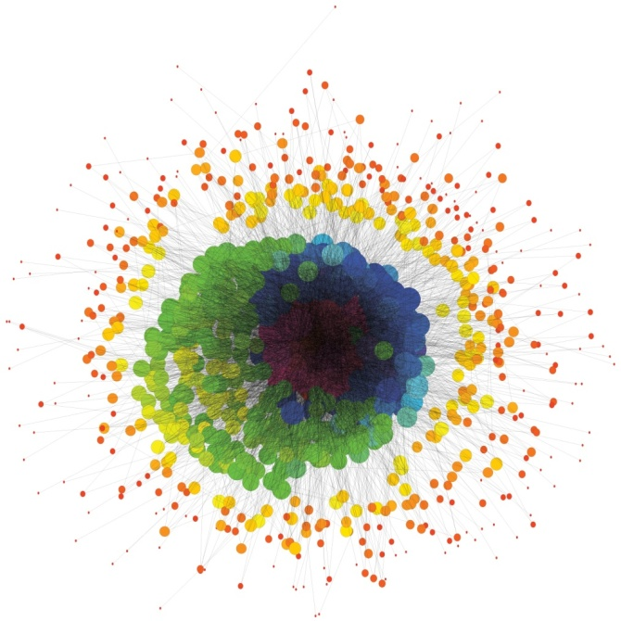
Breadth First Search and Graph500
0
Breadth-First Search (BFS) algorithm:
Search in a graph structure
Neighbors first
Used in many graph theory problems (shortest path, bipartiness, …)
Graph500 benchmark
BFS is the main kernel used for ranking graph processing capabilities of supercomputers
Kronecker graph as input
Baseline implementation
Based on the original Graph500
Two-sided nonblocking point-to-point communication
Multithreaded computation + communication
1
2
3
4
5
6
This small, synthetic graph was generated by a method called Kronecker multiplication. Larger versions of this generator, modeling real-world graphs, are used in the Graph500 benchmark. (Courtesy of Jeremiah Willcock, Indiana University) [Sandia National Laboratory]

Slide 183
MPI+Argobots BFS Implementation
P0
Basic traversal
Each MPI rank owns a subset of vertices
Bulk-synchronous traversal
Global synchronization at each level
Level i-1
Level i
Level i+1
P1
Level i-1
Level i
Level i+1

Slide 184
MPI+Argobots BFS Implementation
Basic traversal
Each MPI rank owns a subset of vertices
Bulk-synchronous traversal
Global synchronization at each level
Argobots extensions
ULTs process few vertices in the current level
ESs access mostly their main pool
Work-stealing occurs for load-balancing
Event processing
ESs can access all pools
Shrinking: the main pool of the victim ES will be processed by other ESs seamlessly
Expanding: the new ES will be connected to the pools, while electing one of them as its main pool
Level i-1
Level i
U3
U4
U5
U6
U7
U8
U9
Fine-grained units
U0
U1
U2
Coarse-grained units
P0
P1
P2
ES0
ES1
ES2
S0
S1
S2
M
P
I
Core
Core
Core

Slide 185
MPI+ULT
“MPI+ULT: Overlapping Communication and Computation with User-Level Threads”, Huiwei Lu, Sangmin Seo and Pavan Balaji. IEEE International Conference on High Performance Computing and Communication (HPCC), Aug 24—26, New York, USA.

Slide 186
Software Trends in Supercomputing
MPI+X becomes a promising programming model
X: Pthreads, OpenMP, TBB, MPI shared memory…
Better memory sharing within the node
Better parallelism within the node
However, most “X” only considers intra-node optimization
Need another “X” for optimizing inter-node communication

Slide 187
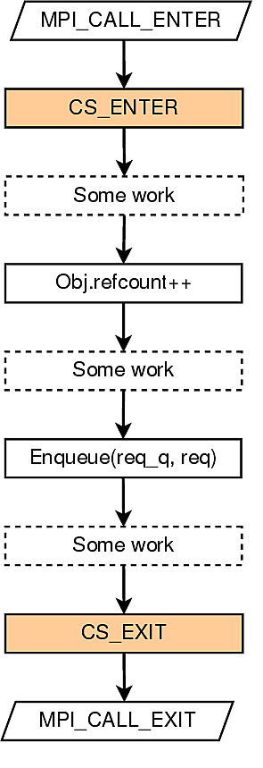
Latency Hiding in MPI with Existing Methods
MPI Nonblocking functions
Low overhead
Overlap each function one at a time
Provide for nonblocking pt2pt functions and collectives, but does not support some MPI one-sided functions like MPI_Win_Flush
MPI+Threads using Pthreads or OpenMP
Modulized, able to overlap several blocking communication functions at the same time
High thread overhead from the locks [Amer 15]
Need lightweight thread mechanism for latency hiding!
Fig. Global lock to support thread safety in MPI [Amer 15]
[Amer 15] Abdelhalim Amer, Huiwei Lu, Yanjie Wei, Pavan Balaji, Satoshi Matsuoka. MPI+Threads: Runtime Contention and Remedies. PPoPP’15

Slide 188
Outline
Introduction and Motivation
MPI+ULT Design and Implementation
Micro-Benchmarks
Applications
Conclusion

Slide 189
User-level Thread (ULT)
What is User-level Thread (ULT)
Provides thread semantics in user space.
Execution model: cooperative timesharing
More than one ULT can be mapped to a single kernel thread
ULTs on the same OS thread do not execute concurrently
Can be implemented with coroutines
enable explicit suspend and resume of its progress by preserving execution state
some languages such as Python and Go use coroutines for asynchrnous I/O
Why ULT?
Kernel threads (e.g., pthreads) are too expensive for computation/communication overlap
Where to use?
To better overlap computation and communication/IO
ULT₁
Context switch
ULT₂
Context switch
timeline

Slide 190
MPI Interoperation with ULT
Overlap communication with computation using ULT
Lightweight
ULT does not execute concurrently using additional hardware resource, but takes turn to run by context switching
No lock needed between two ULTs in the same kernel thread
Asynchronous communication
Helps turn an MPI blocking call to a nonblocking one
Decouples the operation of “send start” and “send complete”
Dynamic Tasking
Providing automatic overlap based on task-graph dependencies
ULT₁ do computation, start a
MPI send
ULT₁
Context switch to ULT₂, ULT₁ communication
in background
ULT₂
Context switch back to ULT₁, ULT₂ communicate in background
timeline
CPU
NIC

Slide 191
Providing communication/computation overlap w/ ULT
Lightweight
ULT does not execute concurrently using additional hardware resource, but takes turn to run by context switching
No lock needed between two ULTs in the same kernel thread
Asynchronous
Helps turn a MPI blocking call to a nonblocking one
Decouples the operation of “send start” and “send complete”
Modularized
Provide thread abstraction
ULT₁ do computation, start a
MPI send
ULT₁
Context switch to ULT₂, ULT₁ communication
in background
ULT₂
Context switch back to ULT₁, ULT₂ communicate in background
timeline
CPU
NIC

Slide 192
Proposing a new thread level: MPI_THREAD_ULT
The current MPI standard support 4 thread levels
MPI_THREAD_SINGLE: only one thread will execute
MPI_THREAD_FUNNELED: multithreaded, only the main thread will make MPI calls
MPI_THREAD_SERIALIZED: multithreaded, multiple threads may make MPI calls one at a time
MPI_THREAD_MULTIPLE: multiple threads may call MPI with no restrictions
Proposing MPI_THREAD_ULT:
Only one kernel thread will execute but multiple ULTs may call MPI functions with no restrictions.
vs. MPI_THREAD_SERIALIZED: can overlap different MPI calls
vs. MPI_THREAD_MULTIPLE: only one kernel thread allowed in MPI_THREAD_ULT

Slide 193
Timeline of MPI_Send with ULT-aware MPI runtime
User Code
Runtime
User Code
Runtime
MPI_Send
ULT₁ MPI_Send
starts send request
ULT₁ starts send request
ULT₁ polls the progress engine
Time
polls the progress engine
ULT₁ context switch
polling time
ULT₂ computation
No
utilizing polling time
w/ ULT
request finished?
ULT₂ context switch
Yes
ULT₁ polls the progress engine
finishes send request
ULT₁ finishes send request
finishes MPI_Send
ULT₁ finishes MPI_Send
MPI Blocking Send
ULT-aware MPI runtime

Slide 194
Outline
Introduction and Motivation
MPI+ULT Design and Implementation
Micro-Benchmarks
Applications
Conclusion

Slide 195
Experiment Setup
Intel x86_64 cluster named “Blues” at ANL
each node has two Intel Sandy Bridge Pentium Xeon processor
each node has 64 GB RAM
310 nodes connected with QLogic inter-connect
MPICH 3.1.3 compiled with GCC 4.7.2
ULT library uses Qthreads (developed at Sandia National Laboratory)

Slide 196
Overhead of Kernel Threads vs. ULT in MPI
Measuring the aggregate message rate of MPI_Send with destination MPI_PROC_NULL
The overhead of MPI_THREAD_ULT is very small; for Pthreads, the message rate drop significantly because of lock contention
Notes:
slightly drop in #ULT=1/2 is because qthreads runtime cost

Slide 197
Overhead of Point-to-Point Communication
potential overlap for computation
The overhead of communicating with ULT is close to nonblocking MPI functions
The overhead for ULT is from ULT creation and yielding. When the data size becomes bigger, the cost becomes relatively small.

Slide 198
Overhead of Collective Communication
potential overlap for computation
Notes:
NOTE: The reason why MPI_Alltoall w/ ULT is because the MPI_Ialltoall is not optimized as it is newly added after MPI-3, while MPI_Alltoall optimize the algorithm for different data sizes.

Slide 199
Overlap in One-Sided Communication
For each ULT:
for i = 0 to NUM_ITER:
MPI_Get
MPI_Win_flush
computation
MPI_Accumulate
MPI_Win_flush
The MPI one-sided synchronization call (MPI_Win_flush) can almost be fully overlapped with computation
For #ULT=16, 90% of RMA time is overlapped

Slide 200
Outline
Introduction and Motivation
MPI+ULT Design and Implementation
Micro-Benchmarks
Applications
Conclusion

Slide 201
Application: HPCG
High Performance Conjugate Gradient (HPCG)
Solves Ax=b, large and sparse matrix
Hiding Global Collective Communication
at end of each iteration, do DDOT to calculate tolerance (vector multiplication + MPI_Allreduce)
overlap communication and computation (overlap DDOT with MG in the next iteration)
fork a ULT to do ult_ddot and join in the next iteration
internal
external
(i,j,k)
A x = y
for k = [1: max_iter]:
MG(A, r, z);
if k > 1:
ult_join (thread);
if (normr <= tolerance) break;
……
ult_fork(ult_ddot, &param, &thread)
HPCG
MG: preconditioner of CG
DDOT: dot product follow by MPI_Allreduce
Notes:
Models 3D PDE. 27-point stencil, communicate with up to 26 neighbors

Slide 202
Application: SpMV in HPCG
Hiding Neighborhood Communication
for each neighbor, fork a ULT to do halo exchange and a small part of SpMV (communication)
main ULT computes local spmv (computation)
internal
external
(i,j,k)
A x = y
SpMV(A, x, &y):
for each neighbor:
ult_fork(es, ult_spmv, &t[i]);
for i in [0: nRows]:
ult_yield();
for each j in row i:
y[i] += val[j] * x[idx[j]];
for each neighbor i:
ult_join(t[i]);
SpMV
Notes:
Models 3D PDE. 27-point stencil, communicate with up to 26 neighbors

Slide 203
HPCG Performance
With small #cores, HPCG w/ MPI+ULT shows little improvement, as DDOT time is small so there is not much to overlap
With 2K cores, HPCG w/ MPI+ULT improved 19.8% compared to MPI-only, benefit from overlapping DDOT with MG

Slide 204
HPCG Time Breakdown
time breakdown
reduce 56.8%
DDOT is overlapped with MG
DDOT time reduced 56.8% (37.2 s), while MG time increased 8.7% (8 s)

Slide 205
HPCG SpMV
Compared to MPI-only SpMV, MPI+ULT SpMV improve performance by 14.8% with 4K cores

Slide 206
HPCG w/ MPI+Qthreads
On 2,048 cores, HPCG using MPI+Qthreads shows performance improvement of 19.8% over MPI-only version, or 34.9% over MPI+Pthreads version.
As core number increases, the benefit of communication hiding begins to reveal. DDOT% increases from 0.62% on 16 cores to 36.8% on 2,048 cores.
Notes:
There are three DDOT operation in HPCG loop. The third one costs most of the time, and is overlapped with MG.

Slide 207
Application: SWAP-assembler
SWAP Genome Assembler [Meng 14]
data partitioned on distributed memory systems
server thread provide data access for other processes
client thread request data from other processes
both server/client thread can call MPI calls independently
[Meng 14]
[Meng 14] J. Meng, B. Wang, Y. Wei, S. Feng, and P. Balaji, “SWAP-assembler: scalable and efficient genome assembly towards thousands of cores,” BMC Bioinformatics, 2014

Slide 208
Application: SWAP-assembler
Process
Kernel Thread
ULT
server
server
client
client
MPI_THREAD_MULTIPLE
server
server
client
client
MPI_THREAD_ULT
[Meng 14]
Replacing MPI_THREAD_MULTIPLE with MPI_THREAD_ULT in communication intensive applications to reduce thread overhead

Slide 209
SWAP Performance
Benefits comes from two parts
1. remove locks in SWAP in user code
2. avoid locks in MPI runtime
For smaller #cores, the user space improvement is more significant; for large #cores, still get a decent improvement of 2x

Slide 210
Conclusion
MPI+ULT: a new approach to overlap communication and computation in MPI with user-level threads (ULTs)
nonblocking, low overhead and modularized
Extensively supports hiding the communication of
MPI point-to-point calls
MPI collective calls
MPI one-sided synchronization calls.
Enables communication hiding in various applications
Improves HPCG up to 19.8% on 2K cores
Improves SWAP-assembler by 2 to 6.3 times with different configurations

Slide 211
Charm++ over Argobots

Slide 212
Charm++ over Argobots
Mini-apps and real world applications
Charm++ model
Intelligent runtime
Converse runtime
(threading, messaging, scheduler)
Argobots
(ULTs, Tasks, scheduling, etc.)
Communication libraries (MPI, uGNI, PAMI, Verbs)
Charm++ infrastructure
Charm++ with Argobots
Approach
Each Charm++ pthread inside a node (including the communication thread) is implemented as an Argobots ES
Converse
The active messaging layer in Charm++
Converse messages between are enqueued into Argobots pools as tasks
Converse threads (CthThread) are implemented on top of Argobots ULTs, with conditional variables to implement suspend/resume
* Team members: Laxmikant Kale, Jonathan Lifflander (UIUC)

Slide 213
Charm++ over Argobots: Implementation
Shrink/Expand
Implementation with Argobots
Charm++ maintains a set of pools for each scheduler, mapped to an ES
Ranks in Charm++ are virtualized by saving the mapping of pool to a ES
When an ES is removed, the associated pools are put into a global list
To maintain correctness in Charm++, the rank of any tasks/threads in the global list are derived from the pool (ranks are virtualized)
Shrink
Other ESs execute work units from orphaned pools with some added synchronization
Expand
A new ES is created and takes over a set of orphaned pools

Slide 214
Charm++ over Argobots: Plan
Goals for Next Year
Implementation and completeness
Charm++ “megatest” passes with current implementation!
More testing is required for complete robostness
Message priorities are currently not implemented
Performance analysis
We’ve just touched the surface of analyzing performance with Argobots
Comparisons needed between the overheads induced by Converse and Argobots
Interoperation
Need to write interoperation tests with other models (MPI, Cilk, etc.)

Slide 215
CilkBots

Slide 216
Dynamic Task Splicing with Cilk + Argobots
Cilk built on Argobots
Each Cilk worker (previously pthread) is now an Argobots Execution Stream
The Cilk work stealing scheduler runs in a Argobots ULT
Fuse together multiple spawn trees to improve locality
Distinct spawn trees require their own stack
Create a new Argobots ULT for each spawn tree root to fuse
Modify Cilk compiler to generate Argobots ULT function wrapper
A steal may require stealing from multiple ULTs (or spawn trees)
Motivation
Code may be in different libraries, manual fusion not possible
Dependencies between phases may inhibit manual fusion
Implemented simple application
Matrix Vector Product and Transpose (PolyBench: mtv)
Two concurrent phases that read entire matrix A
Cache locality can be improved if they are fused
spawn
spawn
continuation
spawn
continuation
Fused ULT N
…
Fused ULT 2
Fused ULT 1
RWS ULT
Argobots ES
Cilk “Worker”
* Team members: Jonathan Lifflander (UIUC), Sriram Krishnamoorthy (PNNL)

Slide 217
Update on CilkBots over Argobots (1/2)
Completed
Completed initial prototype
Cilk workers as execution streams
One ULT per execution stream
Ongoing work
Fixing a few pending bugs to fully support shrink/expand
Working on LeanMD implementation that combines CilkBots and Charm++

Slide 218
Update on CilkBots over Argobots (2/2)
Locality Optimizations: Completed
Initial prototype complete
Cilk workers as execution streams
Multiple interleaved ULTs per worker
Dependence and data access guided scheduling
Ongoing work
Not yet fully integrated with latest Argobots
Continuing work on cache locality optimization
Fused ULT N
…
Fused ULT 2
Fused ULT 1
RWS ULT
Argobots ES
Cilk “Worker”
CilkBots

Slide 219
CilkBots over Argobots: Implementation
Shrink/expand
Execution begins with maximum possible execution streams
An execution stream to be shrunk is deleted, leaving a hole
Stealing and termination detection work correctly in the presence of holes
Expand operations attempt to fill an existing hole
Sent to a live execution stream
Response time (to a shrink/expand request):
Shrinks at the end of working phases
Grow can be handled at anytime

Slide 220
Locality Optimization for CilkBots over Argobots: Implementation
Execution look-ahead using ULTs
Hybrid depth-first and breadth-first execution
Schedule ULTs to minimize reuse distance between tasks
Attempt to optimize locality past synchronization operations
Track dependences through data accesses
Strictly runtime approach: can optimize across library boundaries without source code analysis
mvt
Jacobi 2D

Slide 221
CilkBots/TASCEL over Argobots: Plan
Grow and shrink
Robust inter-operable notification mechanism
E.g.: Shrink notification on an execution stream with multiple different programming models
Finer-grained grow/shrink intervals
Additional dynamic cache optimizations that exploit argobots ULTs
TASCEL integration
Exploit ULTs to simplify communication overlap in tasks
Performance information:
For global analysis (TASCEL) and comparative analysis across nodes/enclaves (CilkBots)
Working phase granularity, idle times, steal statistics, etc.
Inter-operability scenarios
Each runtime owns its execution stream
ULTs within a shared execution stream
Progress guarantees in various inter-operability modes

Slide 222
Parsec

Slide 223
PTGE: Pluggable Task Graph Engine
Motivation
Large scale applications encompasses tens of millions of tasks, distributed across all participating processes
It is therefore critical to minimize the cost of discovering the tasks, especially in a distributed environment
Expose a user-friendly applications centered programming environment through domain specific extensions
PTGE
Data centric task definition
Minimize the number of tasks by defining symbolic dependencies between sets of tasks
for(i = 0; i < SIZE; i++) task(A[i]) become task([A[i], i in [0 .. SIZE-1]])
Integrate with the communication engine to allow for dynamic creation of incoming data, matched with expected input for task(s)
Hierarchical task scheduling
With the PTGE approach the first stage of scheduling is creating the task
Many possible strategies: first data available, all local data available, I/O prediction cost …
Once the task is created, the graph of tasks is decorated with cost information for the upper level scheduling
Enable multi-directional work/task stealing between hierarchies
* Team members: George Bosilca, Thomas Herault, Damien Genet (UTK)

Slide 224
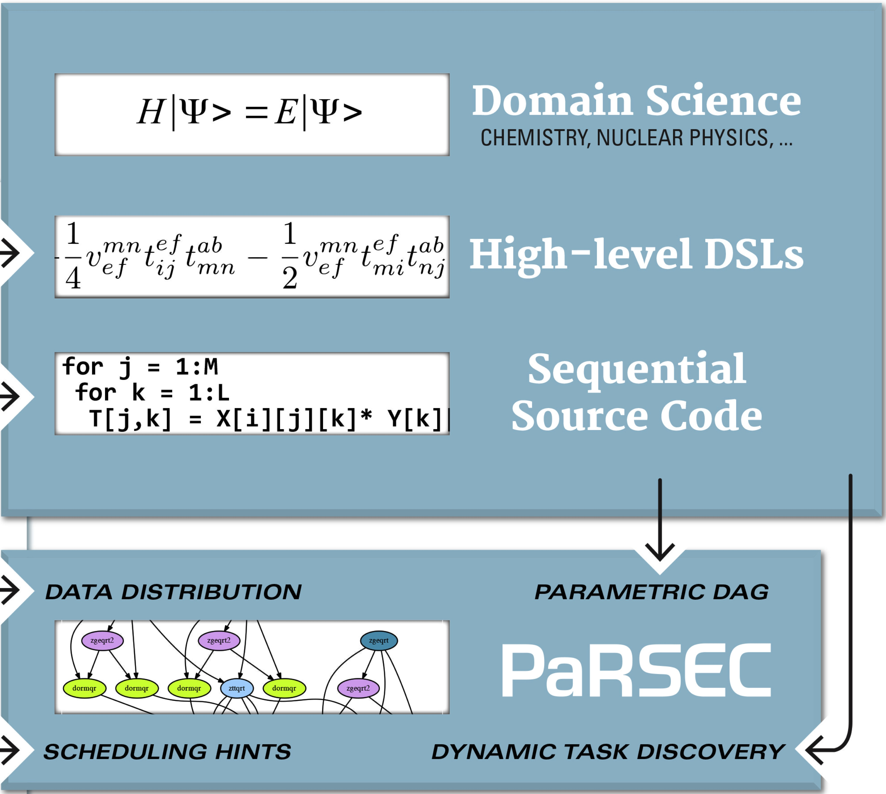
PaRSEC: generic framework for architecture aware scheduling of micro-tasks on distributed many-core heterogeneous architectures
Concepts | Clear separation of concerns: compiler optimizes each tasks, developer describes dependencies between tasks, runtime orchestrates the dynamic execution Interface with the application developers through specialized domain specific languages (PTG, insert_task, fork/join, …) Separate algorithms from data distribution Make control flow executions a relic
Runtime | Permeable portability layer for heterogeneous architectures Scheduling policies adapt every execution to the hardware & ongoing system status Data movements between consumers are inferred from dependencies. Communications/computations overlap naturally unfold Coherency protocols minimize data movements Memory hierarchies (including NVRAM and disk) integral part of the scheduling decisions

Slide 225
The PaRSEC framework
Dense LA
…
Sparse LA
Chemistry
Domain Specific Extensions
Compact Representation - PTG
Dynamic Discovered Representation - DTG
*
Hardcore
Data
Scheduling
Tasks
SpecializedKernels
Parallel Runtime
Scheduling
Tasks
SpecializedKernels
Scheduling
Tasks
Specialized Kernels
Data Movement
Memory Hierarchies
Data Movement
Accelerators
Hardware
Cores
Coherence

Slide 226
Mapping of the PaRSEC machine model into Argobots
Virtual Process
Runtime defined
Execution flow execute tasks sequentially
Can be bound to physical cores or can oversubscribe a resource
A domain is a collection of execution flows with particular hardware properties: memory locality, similar computing capabilities, …
A Virtual Process is a localization domain defining the scope of automatic migration/delocalization
Multiple VP can coexist on the same physical node
Replicate over the total number of nodes
Virtual Process
Virtual Process
Virtual Process
User defined
Virtual Process
Domain
Virtual Process
Domain
Domain
Domain
Domain
Domain
Domain
Domain
Domain
Domain
Domain
Physical Node
Domain
Virtual Process
Physical Node
Virtual Process
Physical Node
Virtual Process
Physical Node
Virtual Process
Physical Node
Virtual Process
Physical Node
Virtual Process
Domain
Domain
Domain
Domain
Domain
Domain
Domain
Domain
Domain
Domain
Domain
Domain
Domain
Domain
Domain
Domain
Domain
Domain
Argobots
Abstract Machine
* Team members: George Bosilca, Thomas Herault, Damien Genet (UTK)

Slide 227
The PaRSEC data
A data-copy is the basic unit of data
Has a memory layout
Has a property of locality (device, NUMA domain, node)
Has a version associated with
Can be replicated
A data is the manipulation token, the basic unit used in the description of the dataflow
Have multiple coherent copies (remote node, device, checkpoint)
They can have different memory layout
Only accessible via the most current version of the data
Can be migrated
Data collections are ensemble of data distributed among the nodes
Can be regular (multi-dimensional matrices)
Or irregular (sparse data, graphs)
Can be regularly distributed (cyclic-k) or arbitrarily
Data View a subset of the data collection used in a particular algorithm
Data View
Data Collection
User defined
Runtime defined

Slide 228
Status summary (1/2)
The lowest machine level has been ported to Argobots:
refocusing all synchronization means to the one provided by Argobots: mutexes, (barriers), conditions and threads
mapping OS-threads to execution streams and ULT
All applications using PaRSEC domain specific task-graph generators now run in shared and distributed memory
Mapping 1-1 between PaRSEC execution units and streams+ult
First cut at porting the communication engine has been completed allowing some applications to run in distributed environments
An effort to add support for accelerators has been initiated

Slide 229
Status summary (2/2)

Slide 230
Demo for SC (1/2)
./demo_server <np> <port_number>
On the application side:
Export environment variables SERVER_HOSTNAME, SERVER_PORT
Commands supported by the server:
An integer to indicate the target MPI process
A character to specify the command
An optional integer to specify the target core (stream)
0 s 2 | MPI process 0 will stop core 2 (if core 2 is running)
1 w 3 | MPI process 1 will start core 3 (if core 3 is sleeping)
0 n | MPI process 0 will send back its cores statuses
q | the server will disconnect from the application

Slide 231
Demo for SC (2/2)
Works in multi-node:
Each MPI process has a communication stream with:
A communication ult, handling all the MPI communication
A communication ult connected to the DEMO server
The server accepts <np> connections
In a node:
Each stream has a status (sleeping, ready, running, stopping)
Between each task, an ULT checks its status
We’re using futures, conditions, and migrations
The computing ULT migrate between its stream and the communication stream (shinking) and, between the communication stream and the new stream (expanding)

Slide 232
Plans for last year
A tighter integration with the Argobots concepts will be pursued, with special emphasis on the scheduling integration and on the capability to allow threads and tasks to collaborate
Unique Argobots generic tasks objects
Better scheduling integration, including multi-level scheduling
The communication engine will be amended to allow for asynchronous progress, up to the level supported by the underlying communication infrastructure
Expose the internal data infrastructure to the other programming approaches through an integration with the Argobots futures
Data movement between different consistency domains (including between different devices) will be implemented.
Investigate the efficiency of hybrid applications where tasks and threads collaborate toward a common goal
ScaLAPACK
Small layer over MPICH-argo to have something close to endpoints
Porting ScaLAPACK on argobots with a larger universe of ULTs than real MPI processes

Slide 233
OpenMP/XMP (RIKEN)

Slide 234
OpenMP/XMP over Argobots
Collaborators:
- US: Sangmin Seo (Argonne)
- JP: Mitsuhisa Sato (RIKEN)
Objective
OpenMP compiler generating work units over Argobots
Efficient for nested loops and tasks
Compiler simply generates ULTs, while the runtime manages them over a fixed set of computational resources
Argobots
Lightweight low-level threading/tasking framework
Designed for massive parallelism
Execution Streams guarantee progress
Work units (ULTs or Tasklets) execute to completion
Explicit mapping ULT/Tasklet to ES
Scheduling policy decoupled and pluggable
ES₁
Sched
ES_{n}
U
S
E
...
T
U
E
T
T
S
E
U
T
T
E
S
U
T
E
Scheduler
Pool
ULT
Tasklet
Event
Argobots Execution Model

Slide 235
Research Activities and Status
Research activities
Tasklets vs. ULTs
If the compiler can analyze and guarantee that an OpenMP thread or task does not have any blocking calls (e.g., pure computation)
Codesigned OpenMP compiler for MPI communication
Funneled-mode or restricted parallel communication
Separation of blocking and nonblocking communication on separate streams
Initial work in progress
More than 3X performance improvement in some cases

Slide 236
Other Collaborations

Slide 237
Collaborations
ROSE compiler infrastructure
Motivation
OpenMP is a popular shared memory programing model and is used with MPI for hybrid programming on clusters.
Argobots can fit in the execution model of OpenMP and improve the performance of OpenMP code, using lightweight context switching, when it is mixed with MPI code.
Goal
Generate an Argobots code from the OpenMP code using the ROSE compiler infrastructure
GridFTP
Motivation
The throughput of data transfer over WAN is limited by the bottleneck component on the end-to-end chain.
Even inside one data transfer node (DTN), data goes through several operations such as read/write to/from disks, compression, send/receive to/from NIC, etc.
If a single thread handles the whole operations, the performance would be much worse than the performance of pipelined operations by multiple threads.
Goal
Improve throughput of data transfer frameworks by applying user-level threading model

Slide 238
Collaborations
hgargo
https://xgitlab.cels.anl.gov/sds/hgargo
Argobots bindings to Mercury RPC API (https://mercury-hpc.github.io/)
RAJA
Test Argobots threading model in RAJA’s loop parallelization
Argobots can be used instead of OpenMP or Cilk
Kokkos
Explore Argobots in the implementation of parallel dispatch of functors
Argobots’ ULTs can be used as device threads
HACC
Look for benefits of applying Argobots to the HACC cosmology code
HACC code is mainly written in OpenMP and MPI
Chombo
Investigate user-level threading in Chombo

Slide 239
ULT/Task Standardization Effort
To develop a common standardized interface for low-level OS-facing lightweight threads
Not to develop a user-facing API for high-level threading models
Higher-level programming models, such as OpenMP, Chapel, TBB, Cilk, Charm++, etc., are expected to be developed on top of this standardized interface
BoF @ SC’15
Title: Towards Standardized, Portable and Lightweight User-Level Threads and Tasks
14 speakers
More than 60 attendees
Just started!
If you are interested in participating, please let us know.

Slide 240
Summary
Massive on-node parallelism is inevitable
Need runtime systems utilizing such parallelism
Argobots
A lightweight low-level threading/tasking framework
Provides efficient mechanisms, not policies, to users (library developers or compilers)
They can build their own solutions
Performance optimizations
To reduce overhead of creating, joining, and destroying ULTs
A single cache or TLB miss may be critical to the performance of ULT operations
On-going and future work
Performance analysis and optimization through use cases
Expand the ecosystem
MPI, OpenMP, OpmSs, XMP, Charm++, Cilk, PaRSEC, etc.

Slide 241
Try Argobots
git repository
http://git.mcs.anl.gov/argo/argobots.git/
Documentation
Wiki
https://collab.cels.anl.gov/display/ARGOBOTS/Argobots+Home
Doxygen
http://www.mcs.anl.gov/~sseo/public/argobots/

Slide 242
Q&A
Thank you for your attention!
Questions?

